Slide 1
Examples of the Phenomenon, Intumescence

Slide 2
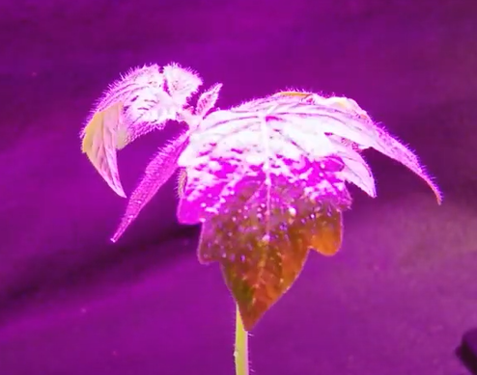
Watch on YouTube: https://www.youtube.com/watch?v=aYeiZCG_D0I
Watch intumescence develop on a tomato seedling under high red light in the back-of-the-classroom demonstration

Slide 3
Watch on YouTube: https://www.youtube.com/watch?v=X6bS8FFC46w
Watch intumescence develop on a tomato plant’s leaf in a glass greenhouse under natural sunlight; the UV wavelengths are screened out by the glass glazing

Slide 4
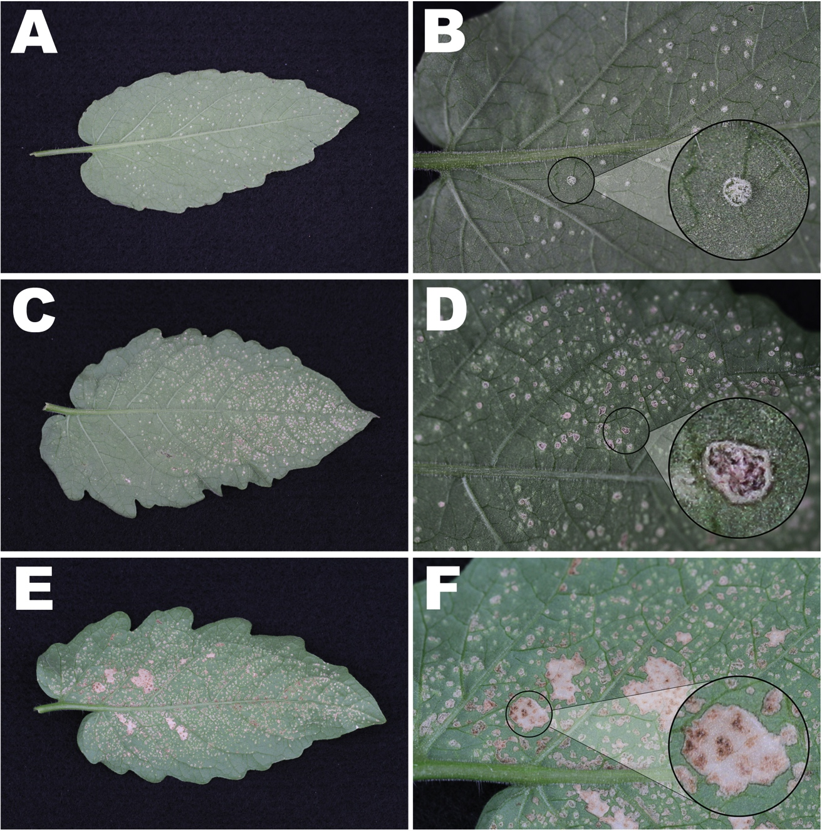
Progression of intumescence in tomato:
Left, three stages of lesion development
Below, normal (A) vs. intumescent (B)
Notes:
Digital images of three stages of lesion development on the abaxial leaf surface of tomato (Solanum lycopersicum ‘Maxifort’). A) Leaf displaying the early stages of lesion development as rounded bumps formed sporadically on the surface. B) Leaf area close-up characterizing solitary lesions that appeared as white-green bumps. C) Leaf displaying the intermediate stages of development as lesions began to senesce and collapse. D) Leaf area close-up characterizing lesions that became brown due to senescence and began to collapse. E) Leaf displaying the latter stages of lesion development as large senescent regions began to appear where lesions previously collapsed. F) Leaf area close-up characterizing a large senesced region where multiple lesions previously collapsed.
Light microscopy cross-sections stained with Toluidine Blue O of lesions on the abaxial leaf surface of tomato (Solanum lycopersicum ‘Maxifort’). A) Asymptomatic leaf; tissue with no lesion development. B) Lesion displaying lower epidermis and spongy parenchyma cells undergoing significant hypertrophy (point) and hyperplasia (arrow) both horizontally and vertically. Abbreviations: lower epidermis (LE); palisade parenchyma (PP); spongy parenchyma (SP); and upper epidermis (UE).

Slide 5
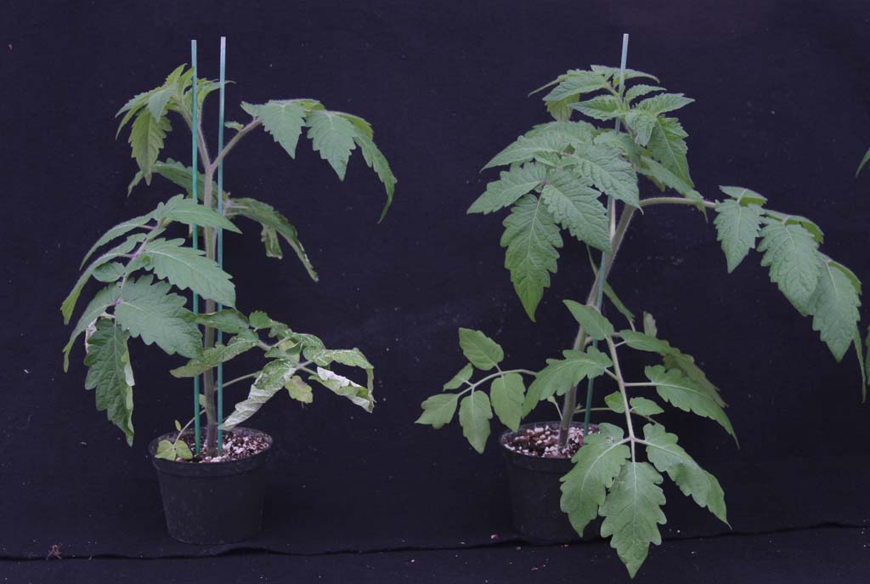
Tomato plant grown in back-of-the-classroom without and with supplemental UVB light
-UVB
+UVB

Slide 6
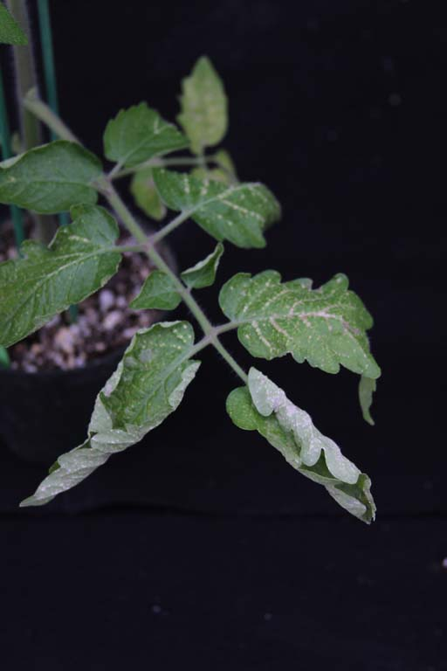
Tomato plant grown in back-of-the-classroom without and with supplemental UVB light
-UVB
+UVB

Slide 7
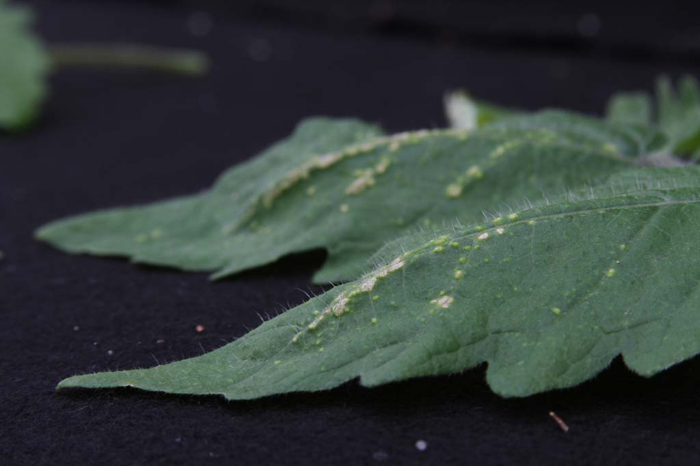
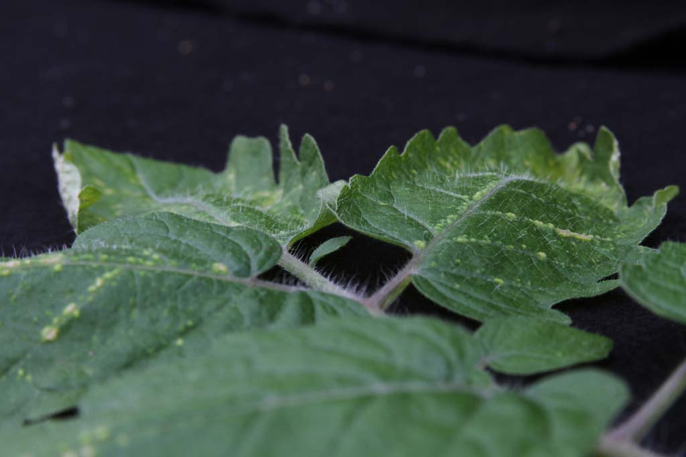

Slide 8
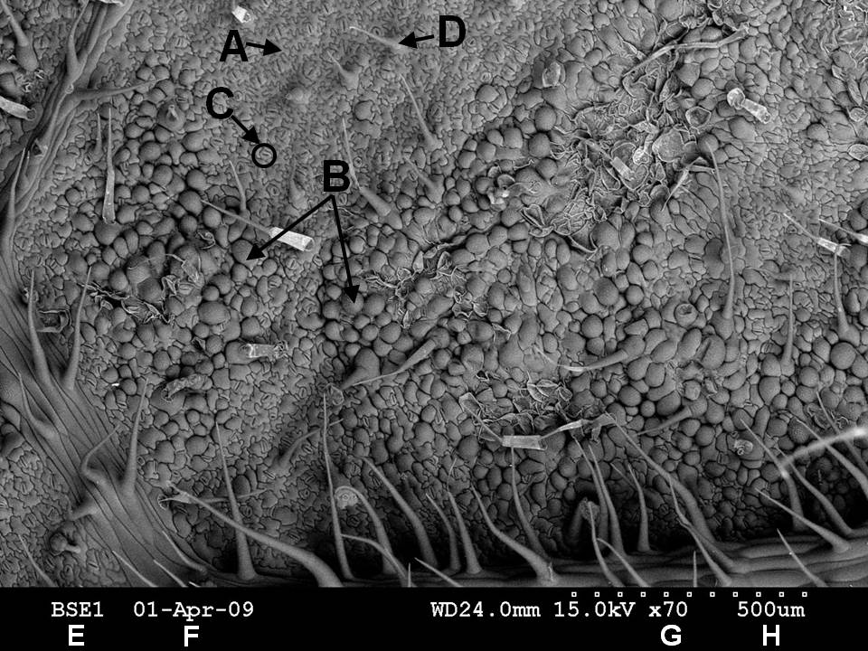
Tomato ‘Maxifort’
Scanning electron micrograph of the abaxial surface of a tomato leaf showing area affected by intumescence development. A: Unaffected cell; B: Intumescence cells exhibiting extreme swelling; C: Stomate; D: Trichome; E: Detector type backscatter electron; F: Date taken; G: Magnification 70X; H: Scale: 500 µm from the first square to the last square on the scale bar

Slide 9
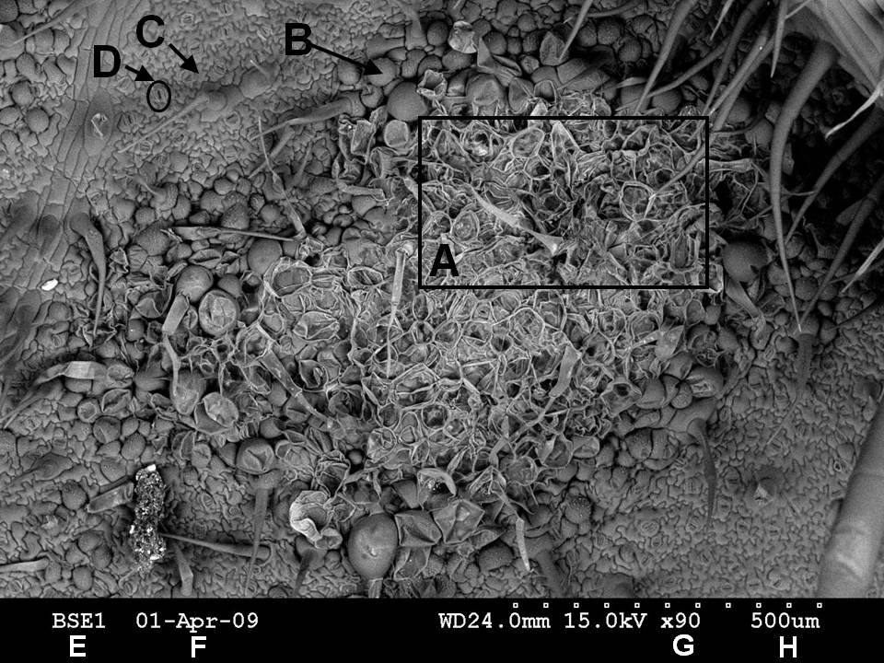
Tomato ‘Maxifort’
Scanning electron micrograph of the abaxial surface of a tomato leaf showing necrotic area affected by intumescence development. A: This area depicts the empty cell walls left after intumescence cells burst; B: Intumescence cell prior to bursting; C: Unaffected cell; D: Stomate; E: Type of scan: backscatter electron; F: Date taken; G: Magnification 90X; H: Scale: 500 µm from the first square to the last square on the scale bar

Slide 10
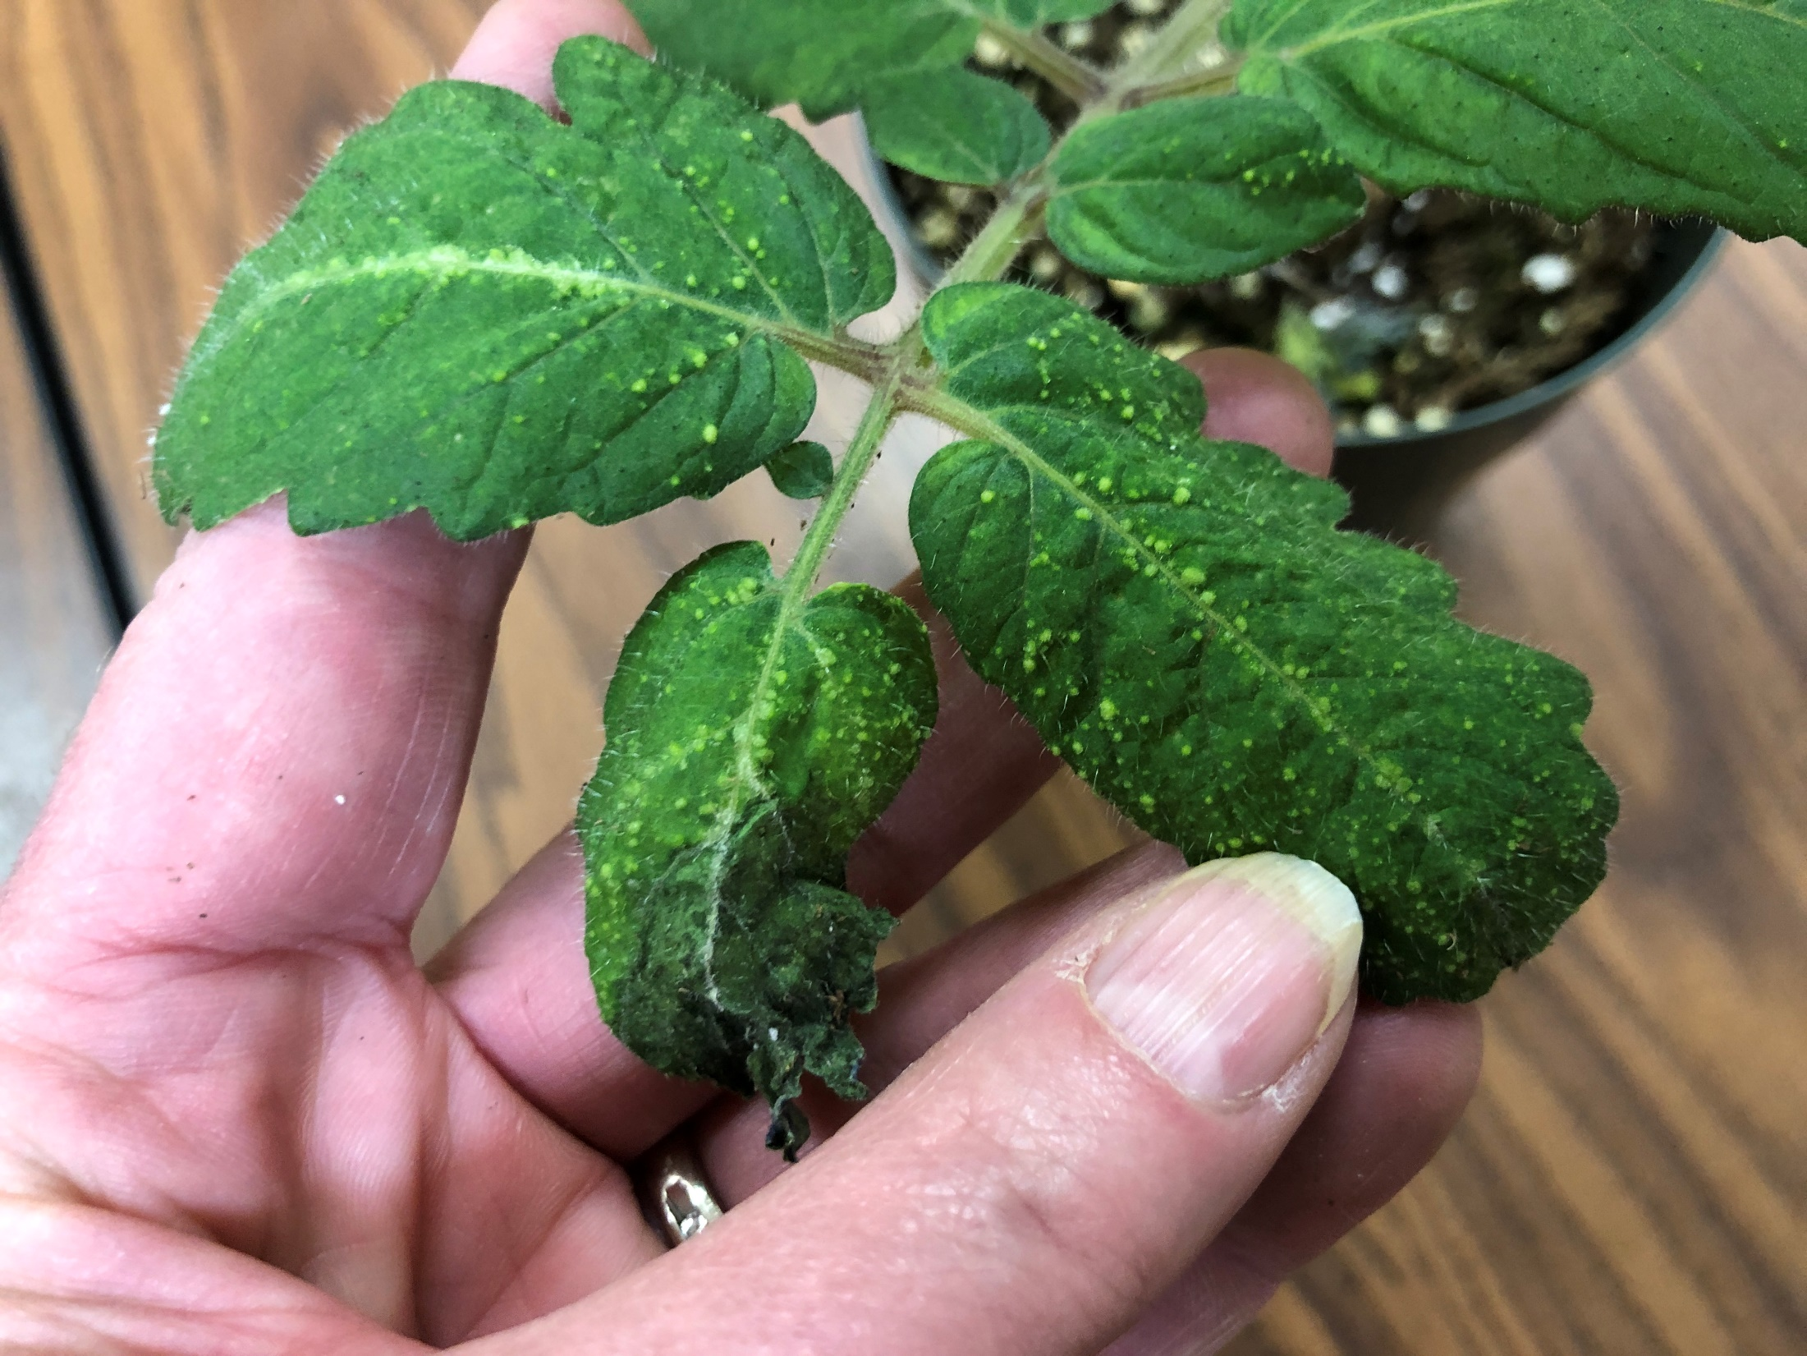
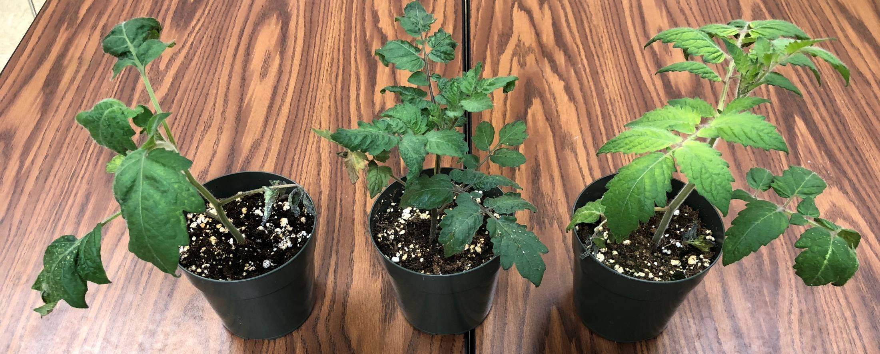
High red
High blue with UV
Full spectrum

Slide 11
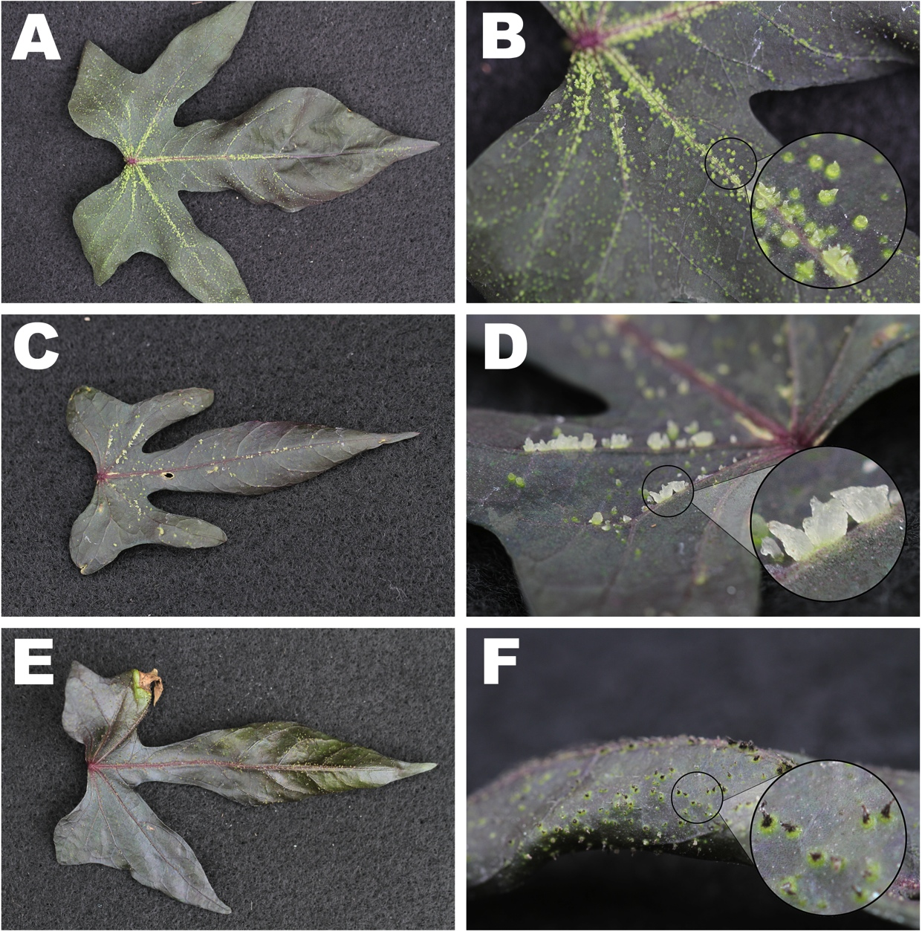
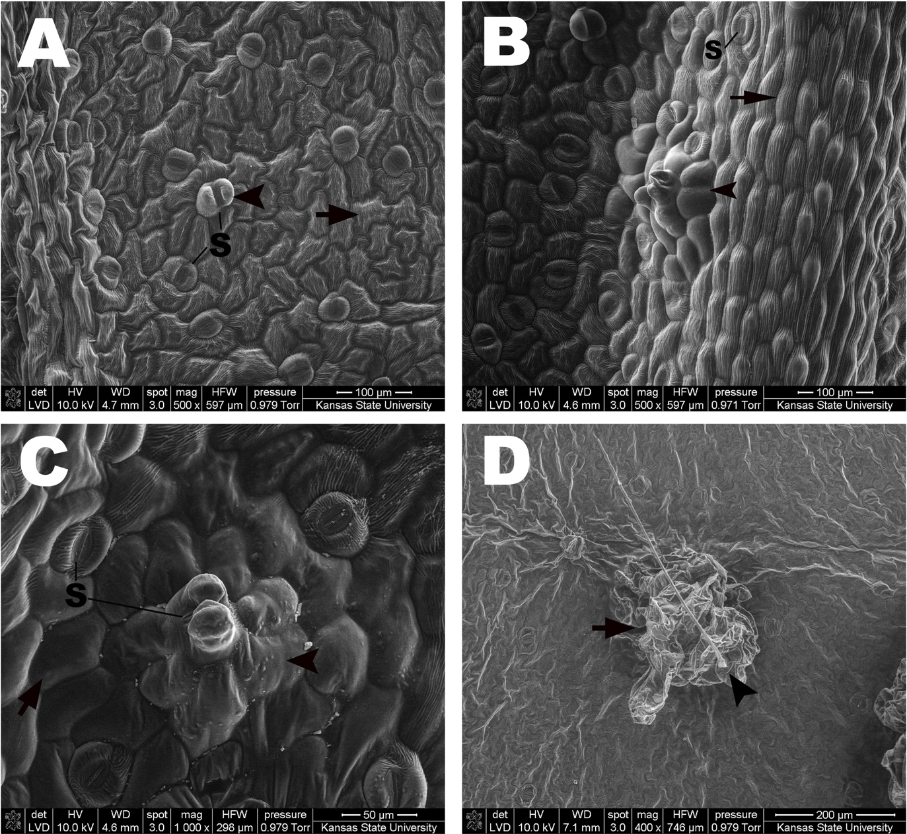
Other plant species develop intumescence: Ornamental sweet potato, Ipomoea batata
Left, three stages of lesion development
Below, initial stages of cell malfunction
Notes:
Digital images of three stages of lesion development on the adaxial leaf surface of ornamental sweet potato (Ipomoea batatas ‘Blackie’). A) Leaf displaying the early stages of lesion development as small green bumps began to form along the leaf veins as well as interveinally. B) Leaf area close-up characterizing the early stages of lesion development as rounded green lesions formed and began to elongate. C) Leaf displaying further elongated and increasingly transluscent lesions which characterized the intermediate stages of development. D) Leaf area close-up characterizing the significant hypertrophy of cells which gave rise to the increasingly translucent appearance of the lesions. E) Leaf displaying the latter stages of lesion development, typical on more mature leaves, with the senescence of lesions apparent. F) Leaf area close-up characterizing the senescence and blackening of the lesion apex.
Field emission scanning electron microscopy of the adaxial leaf surface of ornamental sweet potato (Ipomoea batatas ‘Blackie’). A) Hypertrophy of guard cells (point) occurred during the initial stages of lesion development; hypertrophy did not appear to affect normal epidermal cells (arrow) during these initial stages. B) Hypertrophy of multiple cells (point) during the early stages of lesion development that occurred on the side of a leaf vein (arrow). C) Lesion elongation involved the surrounding epidermal cells (point), with stomata often located at the lesion apex. Normal cells (arrow) around the lesion are unaffected by hypertrophy. D) Lesion in the intermediate stages of development (arrow) with a trichome (point) located near the lesion apex. The potential for artifacts was possible due to the significant desiccation of the tissue in vacuum. Abbreviations: stoma (S).

Slide 12
Other plant species develop intumescence: Batface cuphea, Cuphea llavea
Left, three stages of lesion development
Below, lesion collapse
Notes:
Digital images of three stages of lesion development on the adaxial leaf surface of cuphea (Cuphea llavea ‘Tiny Mice’). A) Leaf displaying the early stages of lesion development as small bumps formed sporadically on the surface both individually and in small groupings. B) Leaf area close-up characterizing lesions that appeared as light green bumps. C) Leaf displaying the intermediate stages of development as lesions began to senesce. D) Leaf area close-up characterizing lesions that became light brown due to senescence, typically beginning at the lesion apex. E) Leaf displaying the latter stages of lesion development as senescent regions began to appear where groupings of lesions had collapsed. F) Leaf area close-up characterizing a collapsed region where multiple lesions previously developed.
Scanning Electron Micrographs: Cuphea (Cuphea llavea ‘Tiny Mouse’) leaf displaying senescence on the abaxial leaf surface due to lesion collapse on the adaxial surface.

Slide 13
Close-up of cuphea intumescence
Leaf cross-sections, right:
no symptoms
Lesion on top of leaf
Lesion on bottom of leaf
Notes:
Light microscopy: Light microscopy cross-sections stained with Toluidine Blue O of lesions on the adaxial and abaxial leaf surface of cuphea (Cuphea llavea ‘Tiny Mice’). A) Asymptomatic leaf; tissue with no lesion development. B) Lesion developing on the adaxial surface displaying extensive hypertrophy of the upper epidermis (point) as well as the elongation of palisade parenchyma cells (arrow). C) Lesion developing on the abaxial surface displaying the hypertrophy of spongy parenchyma cells (point) which are placing pressure on the lower epidermis and potentially leading to rupture (arrow). Evidence for hyperplasia in the spongy parenchyma is also evidenced (caret). Abbreviations: lower epidermis (LE); palisade parenchyma (PP); spongy parenchyma (SP); upper epidermis (UE); and vascular tissue (VT).

Slide 14
Project funded by:
USDA Secondary Education, Two-Year Postsecondary Education, and Agriculture in the K-12 Classroom Challenge Grant (SPECA) Award No. 2017-38414-26963

