Slide 1
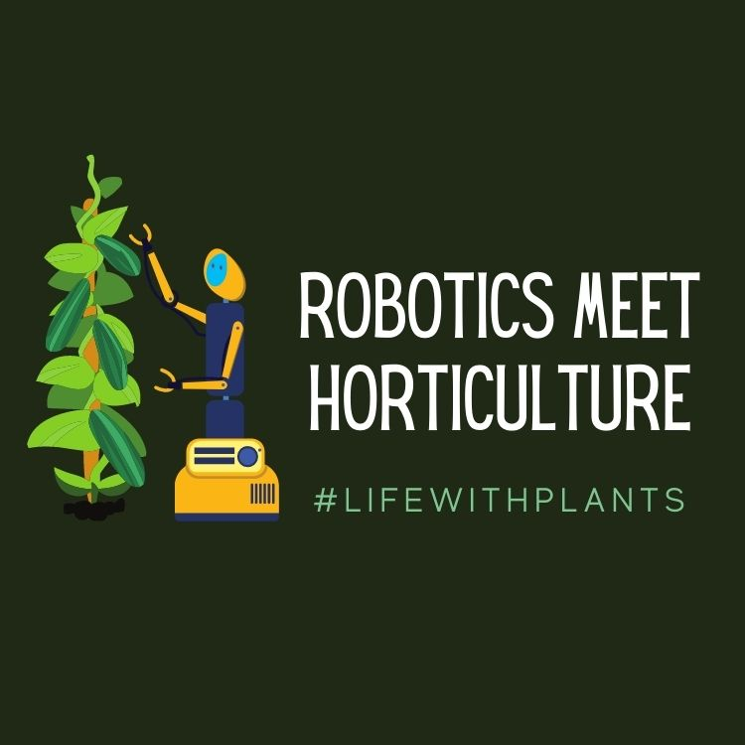

Slide 2
Introduction
Robotics
Examples of robotics in horticulture and plant science related fields
Career opportunities
Notes:
This is the class overview for robotics in horticulture. We will define what robotics are and better understand their use and significance in the horticulture industry. Several examples will be shared and shown. Students will also learn about different horticulture and plant science career opportunities that would include facets of robotic applications and use.

Slide 3
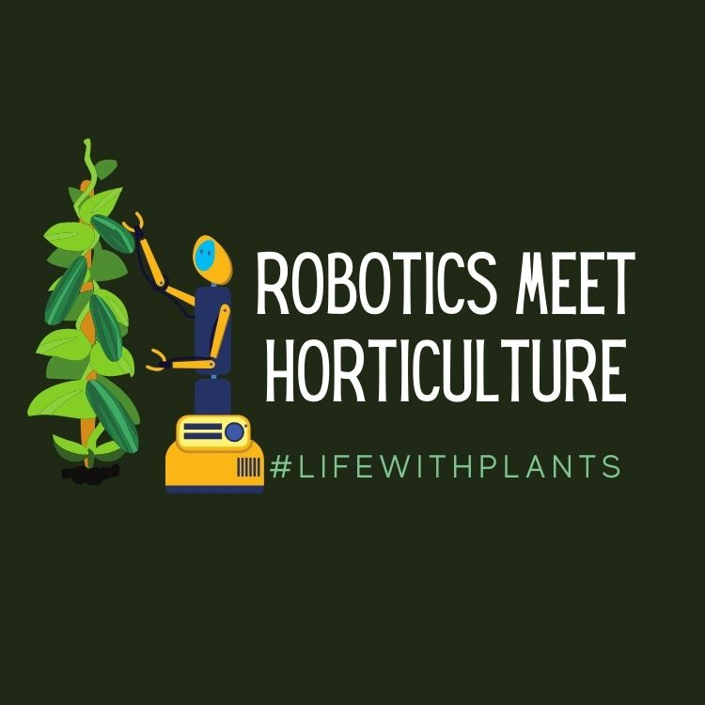
Learning Objectives
Students will:
be able to describe different ways robots are used in horticulture and plant science related fields
Be able to identify and describe different robot types
be able to describe advantages and disadvantages of robotics in horticulture and plant science related fields
Notes:
These are the class objectives associated with robotics in the horticulture industry. By the end of this presentation, students will be able to:

Slide 4
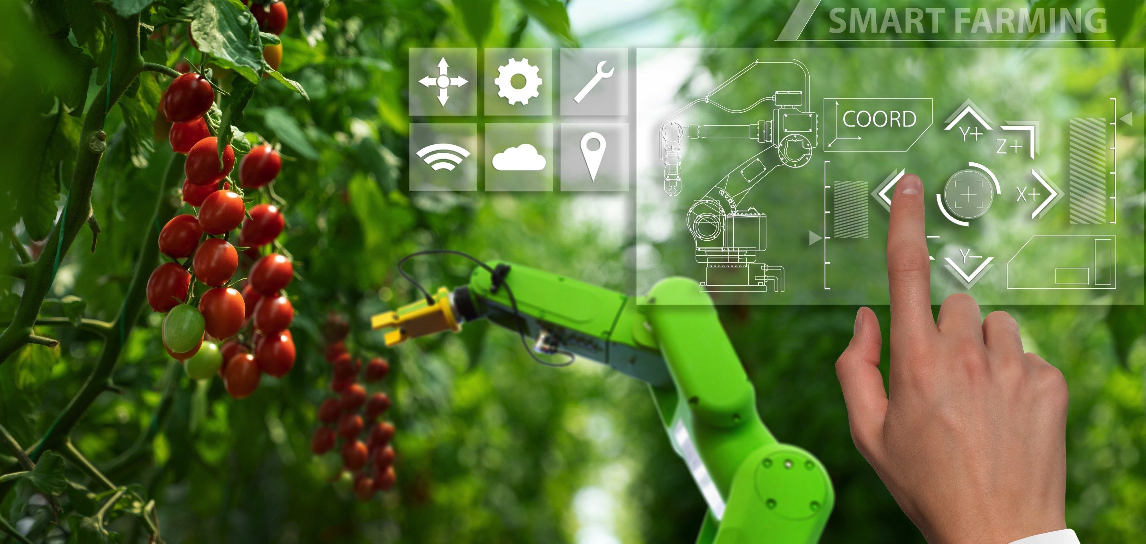
Robotics
What is robotics…?
It’s an interdisciplinary field integrating computers, computer science, technology, along with engineering to produce machines… or robots.
Overarching goal of robotics: assist, replicate, or substitute for humans with various tasks.
Notes:
What exactly is ‘robotics’?
Robotics is the act of integrating computers and computer science, different technologies, coupled with engineering, to build or produce a machine or robot that can function seemingly, on it’s own. These robots require humans to help build, program, and monitor for task completion. (Definition derived from Builtin.com)
The following videos share insight into what the future of produce harvesting can look like in the horticulture and plant science industry.
Video to Watch: ISO: Introducing a New Generation of Machinery using Artificial Intelligence (AI) (1:01)
https://www.youtube.com/watch?v=YMjLCPing6Y
Video to Watch: Root AI –Reveal (1:03)
https://www.youtube.com/watch?v=c-JduOfLEpc
Video to Watch: Root AI—Going Cross-Crop (1:11)
https://www.youtube.com/watch?v=Lh7NO7h7hAM
Video to Watch: Root AI—Introducing Virgo (2:27)
https://www.youtube.com/watch?v=XlXSGqvP-A8

Slide 5
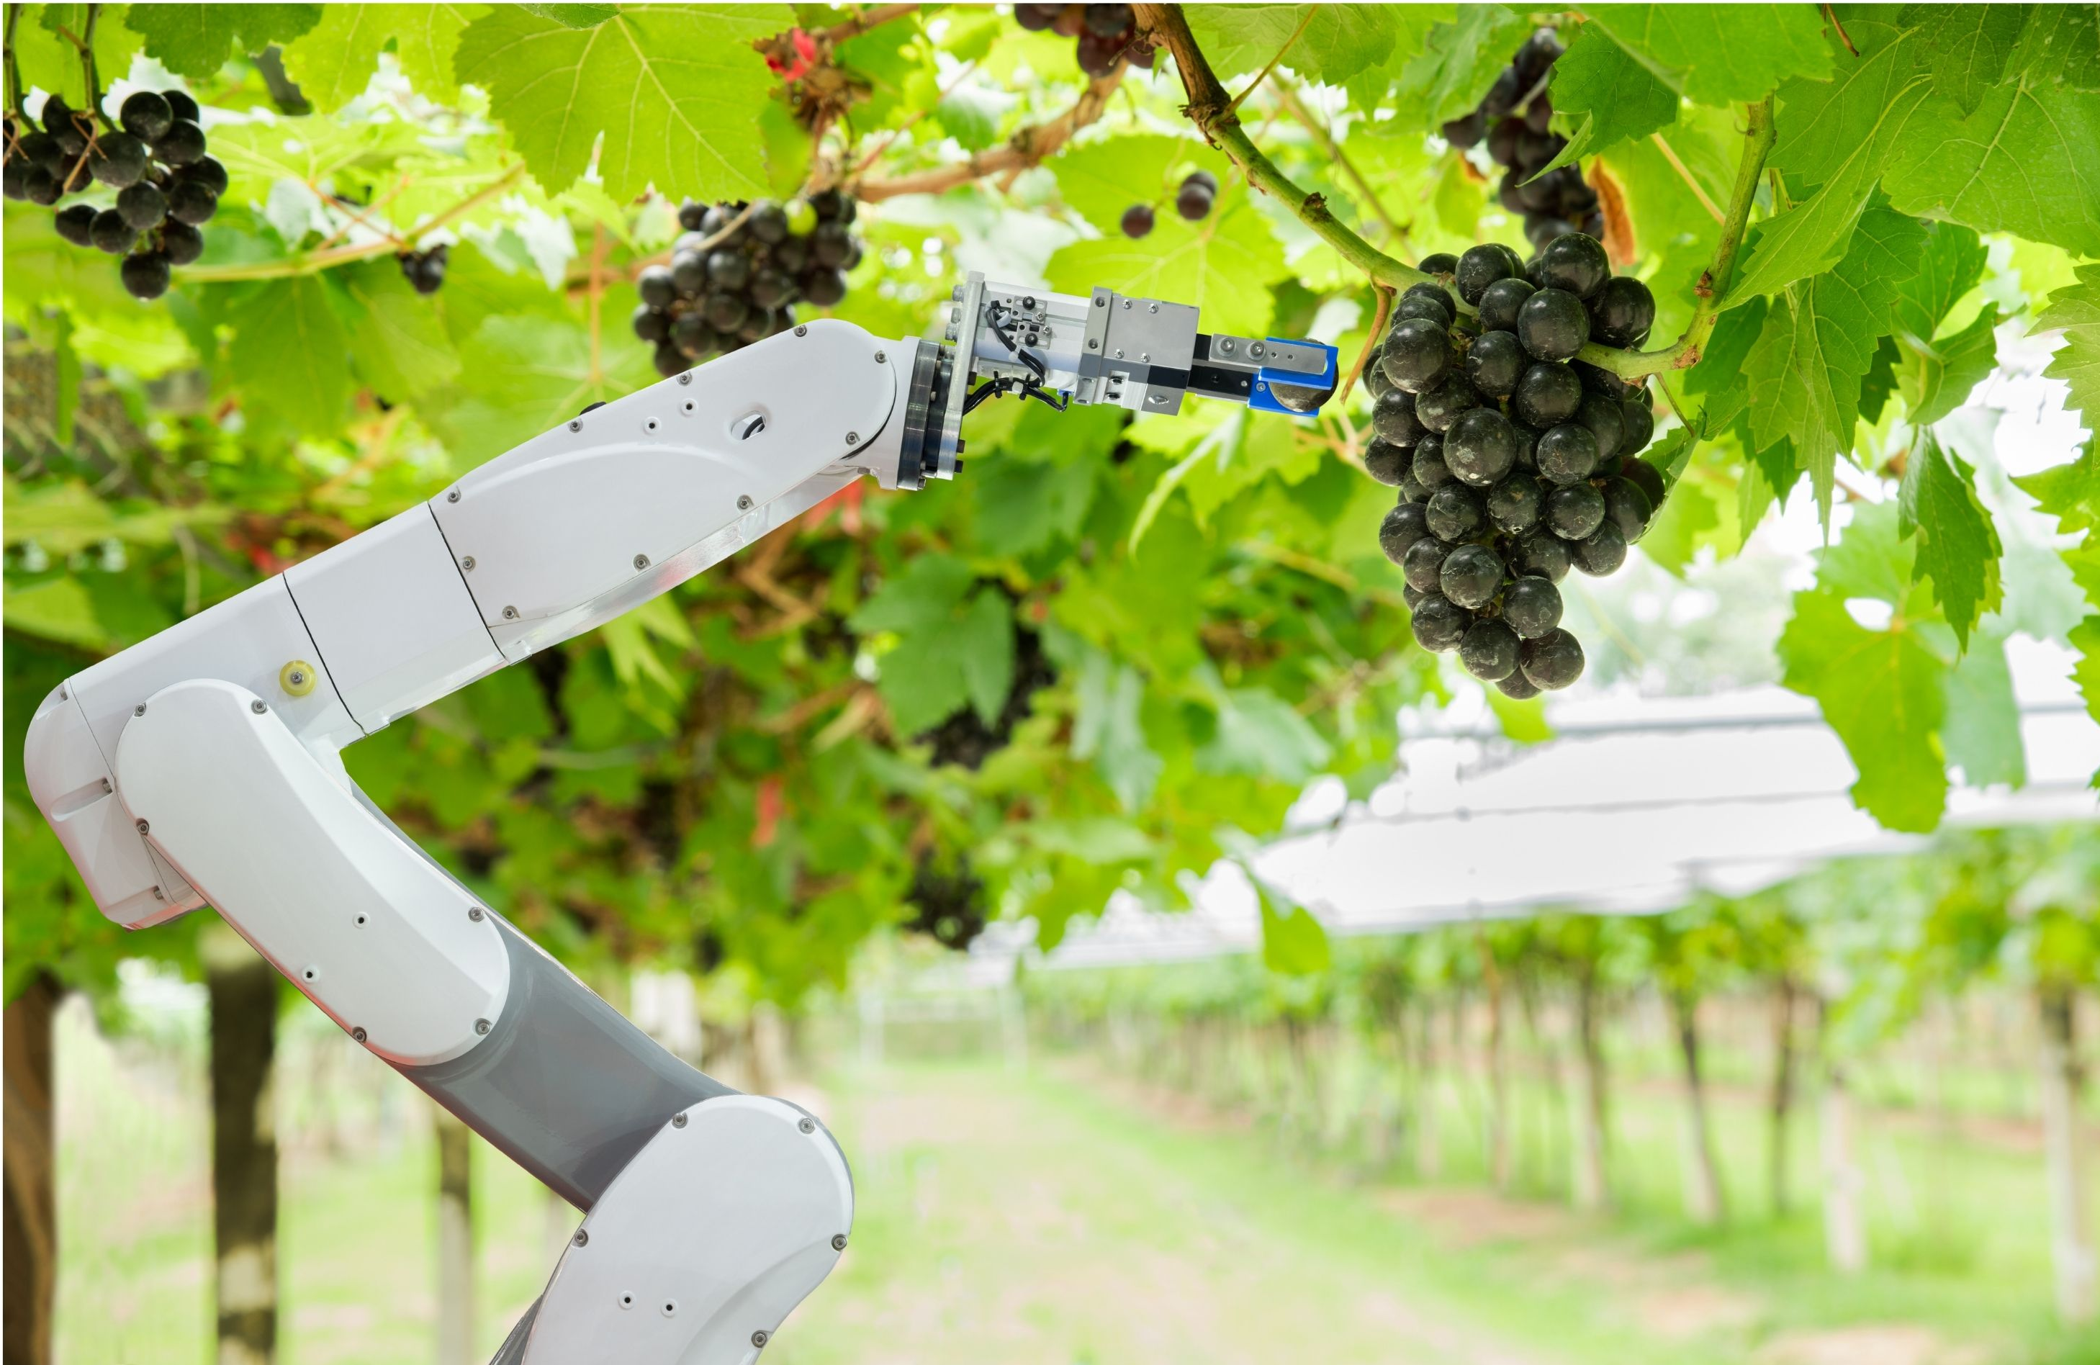
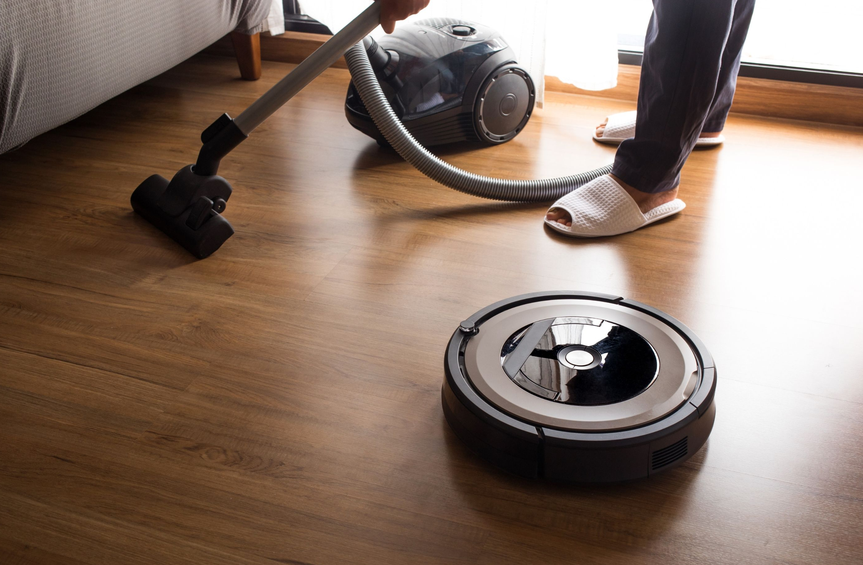
Robotics
Can you name different types of robots?
There are 5 types.
1. Pre-Programmed
2. Humanoid Robots
3. Autonomous Robots
4. Teleoperated Robots
5. Augmenting Robots
Notes:
There are generally five different types of robots.
Pre-Programmed: Generally, programmed to conduct monotonous tasks in a controlled environment. Example is a robotic arm on an assembly line.
Humanoid: Robots that mimic humans. They act and operate like humans.
Autonomous: These robots operate independently from humans. They usually assist with jobs that need no human oversight. Example: Roomba vacuum cleaner.
Teleoperated: These are robots that utilize a wireless network and humans operate at a safe distance. Example: bomb-detecting robots.
Augmenting: Robots that enhance or replace human parts. Example :prosthetic limbs.
Citation: https://builtin.com/robotics

Slide 6
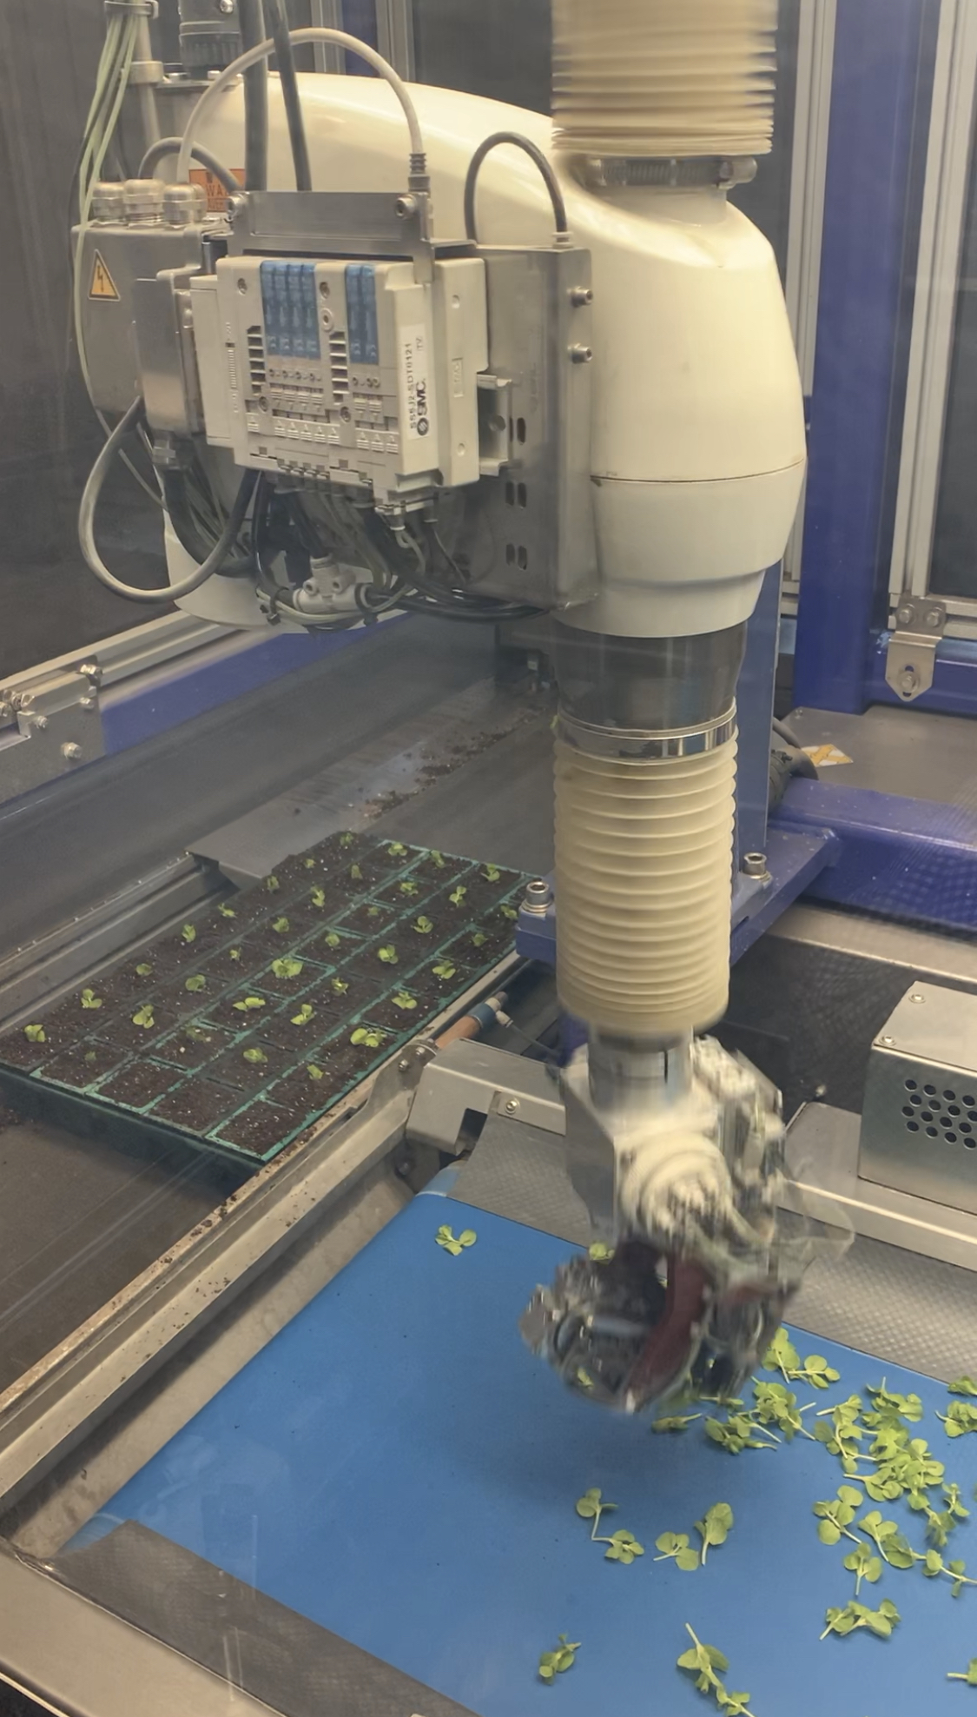
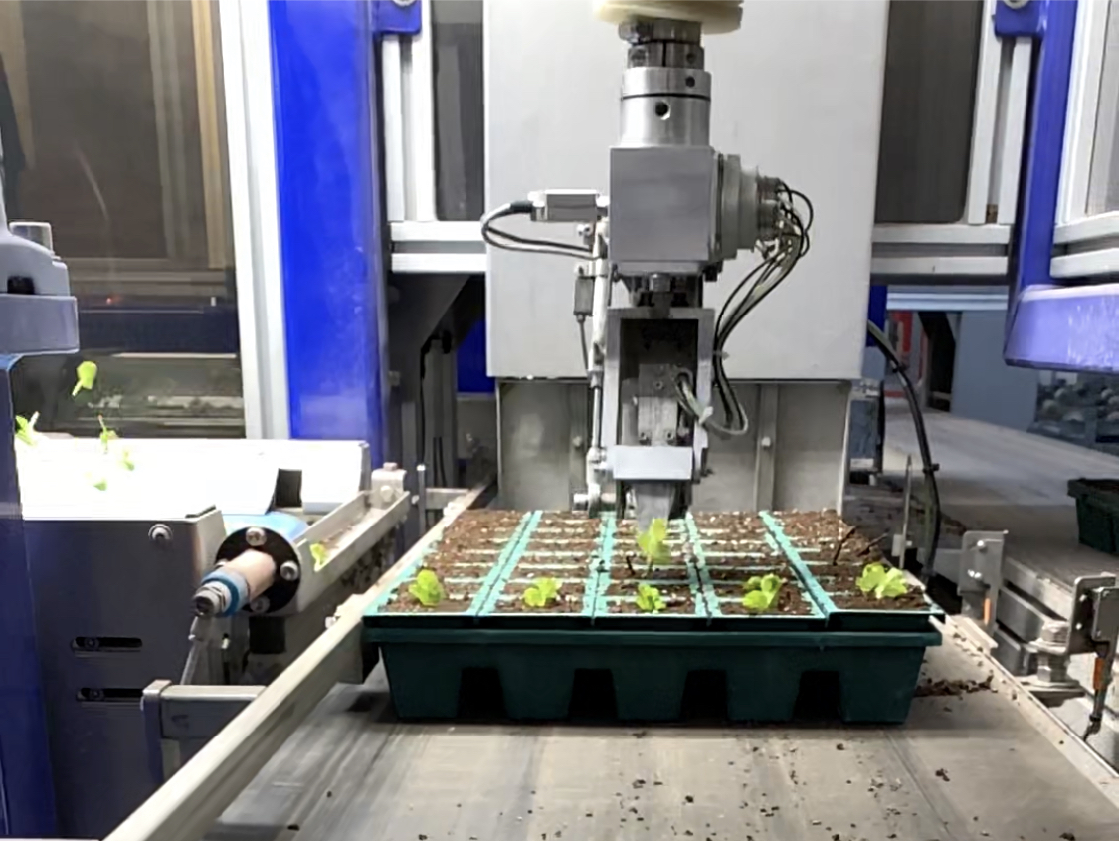
Robotics
Horticulture Applications
Robotic planting arm
Notes:
Sticking Machine robot. This robot assists plant growers with plant cuttings. The cuttings are supplied to the machine by humans and then the robot analyzes and picks up individual cuttings to plant or ‘stick’ into the propagation tray. This robot can stick or plant cuttings, on average of ~2000 per hour. Compare that to a human, which could average about 800.
Metrolina Greenhouses is a large greenhouse production company in the United States. In their production, they utilize a cutting sticker robot, that can plant or stick about 2,000 cuttings per hour.
Video to Watch: Metrolina Greenhouse Cutting Sticking Robot (1:03)
https://www.youtube.com/watch?v=MYJ1C7_N9Ow
In this video, you will observe cuttings being automatically planted using the planting machine. It is very similar to the above video but showing a different angle.
ISO: Automated Cutting Planter; ISO Cutting Planter 4000 (1:59)
https://www.youtube.com/watch?v=VGE69FbxD_g

Slide 7
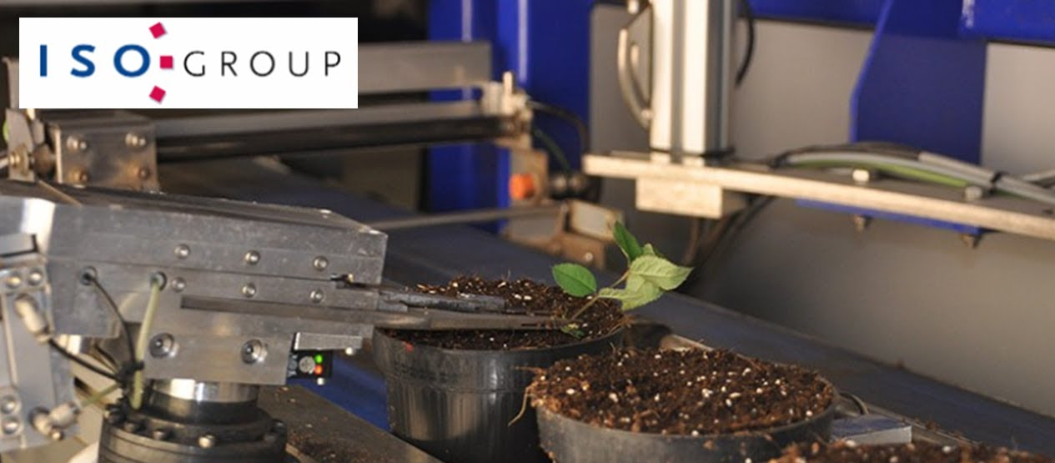
Robotics
Horticulture Applications
Robotic cutting and planting robot
Notes:
Robots have been developed to assist with propagating plants. For example, some plants might be a challenge to take cuttings, like a rose, with their thorns. And, for some cuttings, being very precise and uniform can lead to a better end-product. Thus, a robot could be a better option. In this example, the robot not only makes the cutting, but it also then immediately takes the rose cutting and plants it. This can be very efficient and reduce cost inputs.
Image Credit: ISO Groep; https://www.iso-group.nl/
Video to Watch: ISO: Automated Cutting and Planting of Roses; ISO Robot 1800 (0:50)
https://www.youtube.com/watch?v=UT1i6fIVSl0

Slide 8
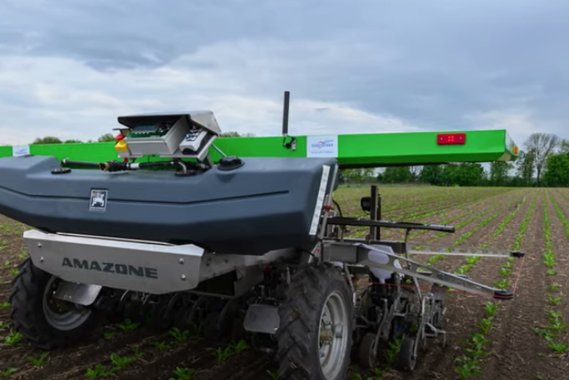
Robotics
Horticulture Applications
Pesticide, herbicide, fertilization applications
Notes:
Robots have been developed to assist production managers and growers to more precisely apply different pesticides, herbicides, and fertilizers to crops, both in the field and in protected environment production practices. These robots are beneficial as they can increase efficiency and safety of the application of these products, as they can utilized stored data and imaging to better precisely apply the chemicals.
Image Credit: www.suedzucker.de/en
Video to Watch: Weed Control in field sugar beet production (2:50)
https://www.youtube.com/watch?v=N-zZm01iBQU&t=104s

Slide 9
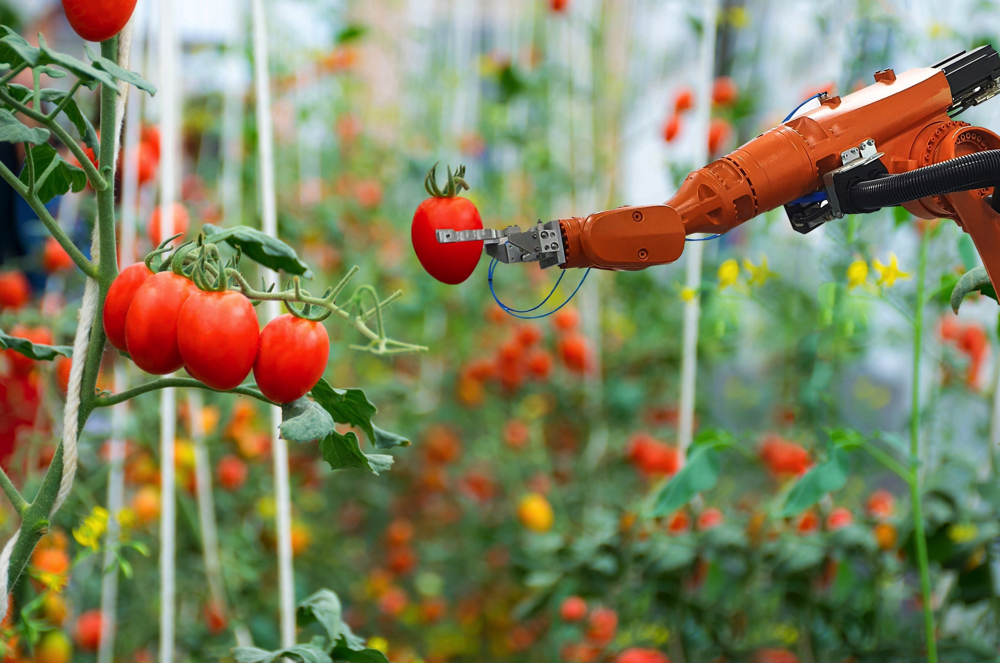
Robotics
Horticulture Applications
Robotic Fruit and Produce Harvester and Packager
Notes:
One area of development for robotics in the horticulture industry focuses on fruit and produce harvesting. Development of robots that can analyze and determine the correct stages for fruit and produce harvest are already being tested and implemented in the industry. The robots are designed to be able to carefully harvest the product without causing harm or damage to the products. Robotics are not only being used to assist with harvesting, but also with additional steps in the production chain, including packaging.
In the below video, a brief insight is provided into the development of an apple picking robot, with researchers from Michigan State University and the United States Department of Agriculture (USDA).
Video to Watch: Michigan State University and United States Department of Agriculture Apple Picking Robot (1:56)
https://www.youtube.com/watch?v=lake45LOd98
Video to Watch: Robotics Arms Race (2:15)
https://www.youtube.com/watch?v=-PtqZA2enkQ
This video shows the use of robotics for picking fruit in an orchard in New Zealand.
Video to Watch: Autonomous Grape Harvesting Robot Development (7:48)
https://www.youtube.com/watch?v=ssWetc3PHkY
This video highlights the development and the process in which a grape picking robot was developed at the British Columbia Institute of Technology, as a senior capstone project.
Video to Watch: Robot-Assisted Pepper Packing (2:20)
https://www.youtube.com/watch?v=m0IcEjgUDVQ
Robots assist with fruit and vegetable post harvesting processes. In this video, you will see how robotics and machines assist with packaging bell peppers.
Video to Watch: AGROBOT Robotic Strawberry Harvester (1:29)
https://www.youtube.com/watch?v=M3SGScaShhw
Agrobot showcases an innovative robot strawberry harvester, developed for field cultivation and harvesting, in addition to protected environment (greenhouse and hightunnel) production.

Slide 10
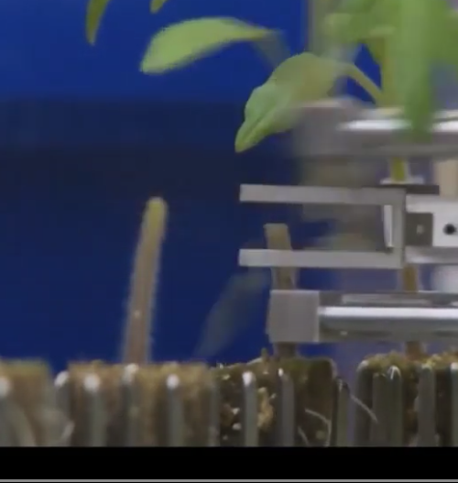
Robotics
Horticulture Applications
Plant Grafting
Notes:
Grafting is a propagation method that combines two plants together: A rootstock and a scion. This can become a tedious task, especially when performing thousands of grafts for production purposes. An example in this video shows tomato plants being grafted. The process requires a human to put a plant into the robot, and the robot then cuts and grafts plants as appropriate.
Image Credit: ISO Groep: ; https://www.iso-group.nl/
This video shows automated plant grafting of tomato plants.
Video to Watch: ISO: Automated Tomato Grafting; ISO Graft 1200 (1:39)
https://www.youtube.com/watch?v=a8uGVHft8vI

Slide 11
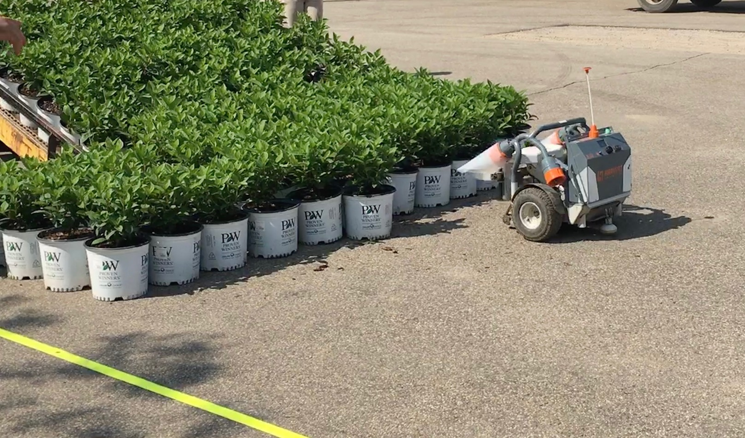
Robotics
Horticulture Applications
Plant and product spacing robot
Notes:
Robotics have been used in the nursery areas of the horticulture industry. Robots like the one shown here in the slide, operate to move and properly space plants. This can save time and labor costs, as plants like those shown here, can come from a transplanting line (potentially automated) and placed on the ground, without immediate spacing. Then the robot can be programmed, based on container and spacing specifications to carry out the remaining task to continue to produce the plants.
Metrolina Greenhouses is one of the largest greenhouse growers in the United States. This brief video shows how they utilize robots in the production of different floriculture crops.
Video to Watch: Robots Working at Metrolina Greenhouses (0:35)
https://www.youtube.com/watch?v=xBIwj6SMuLc

Slide 12
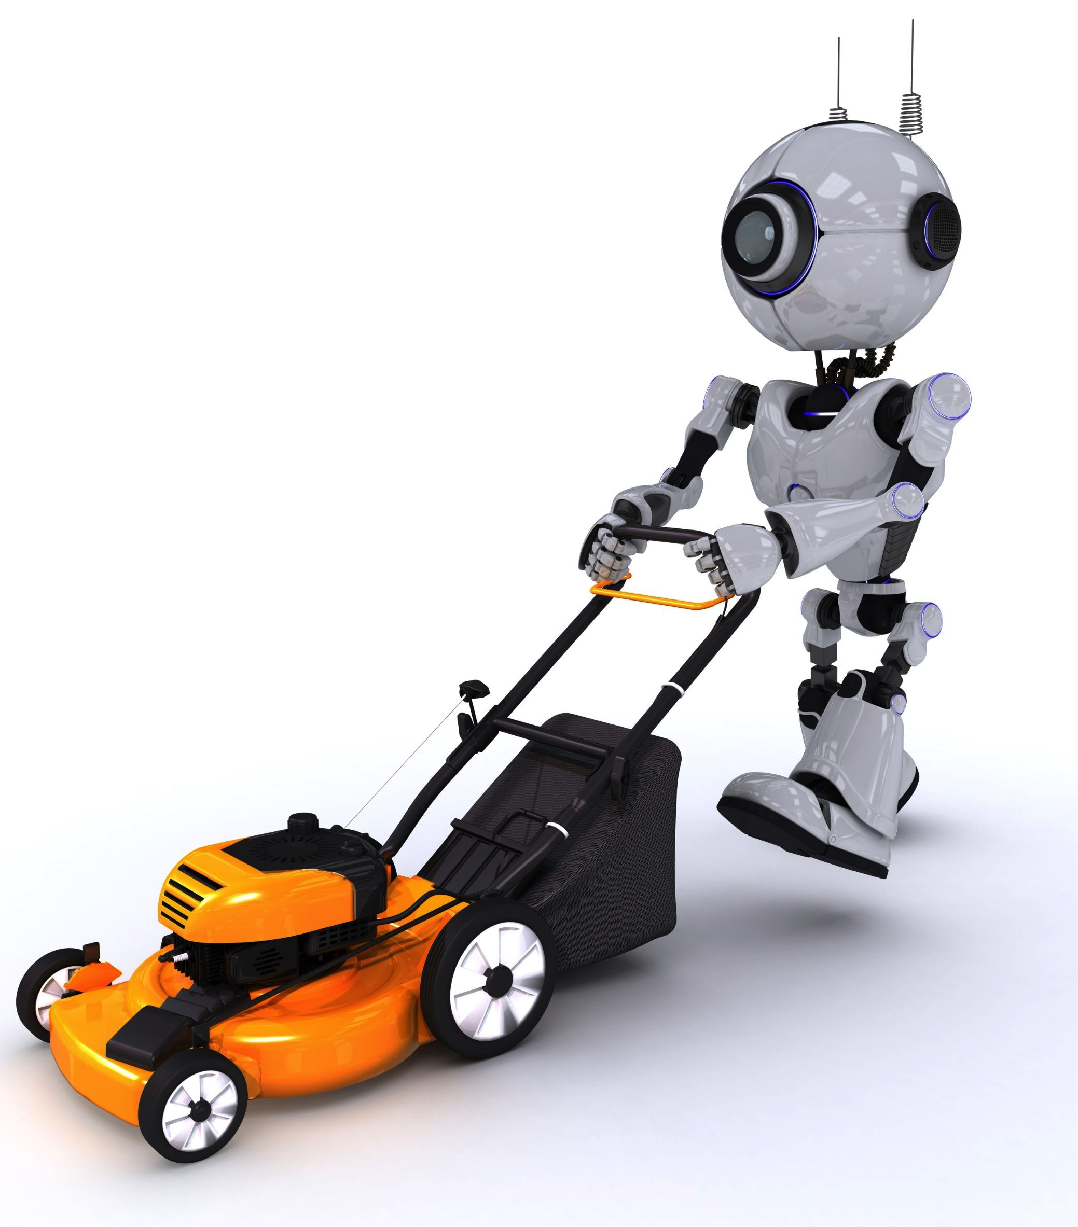
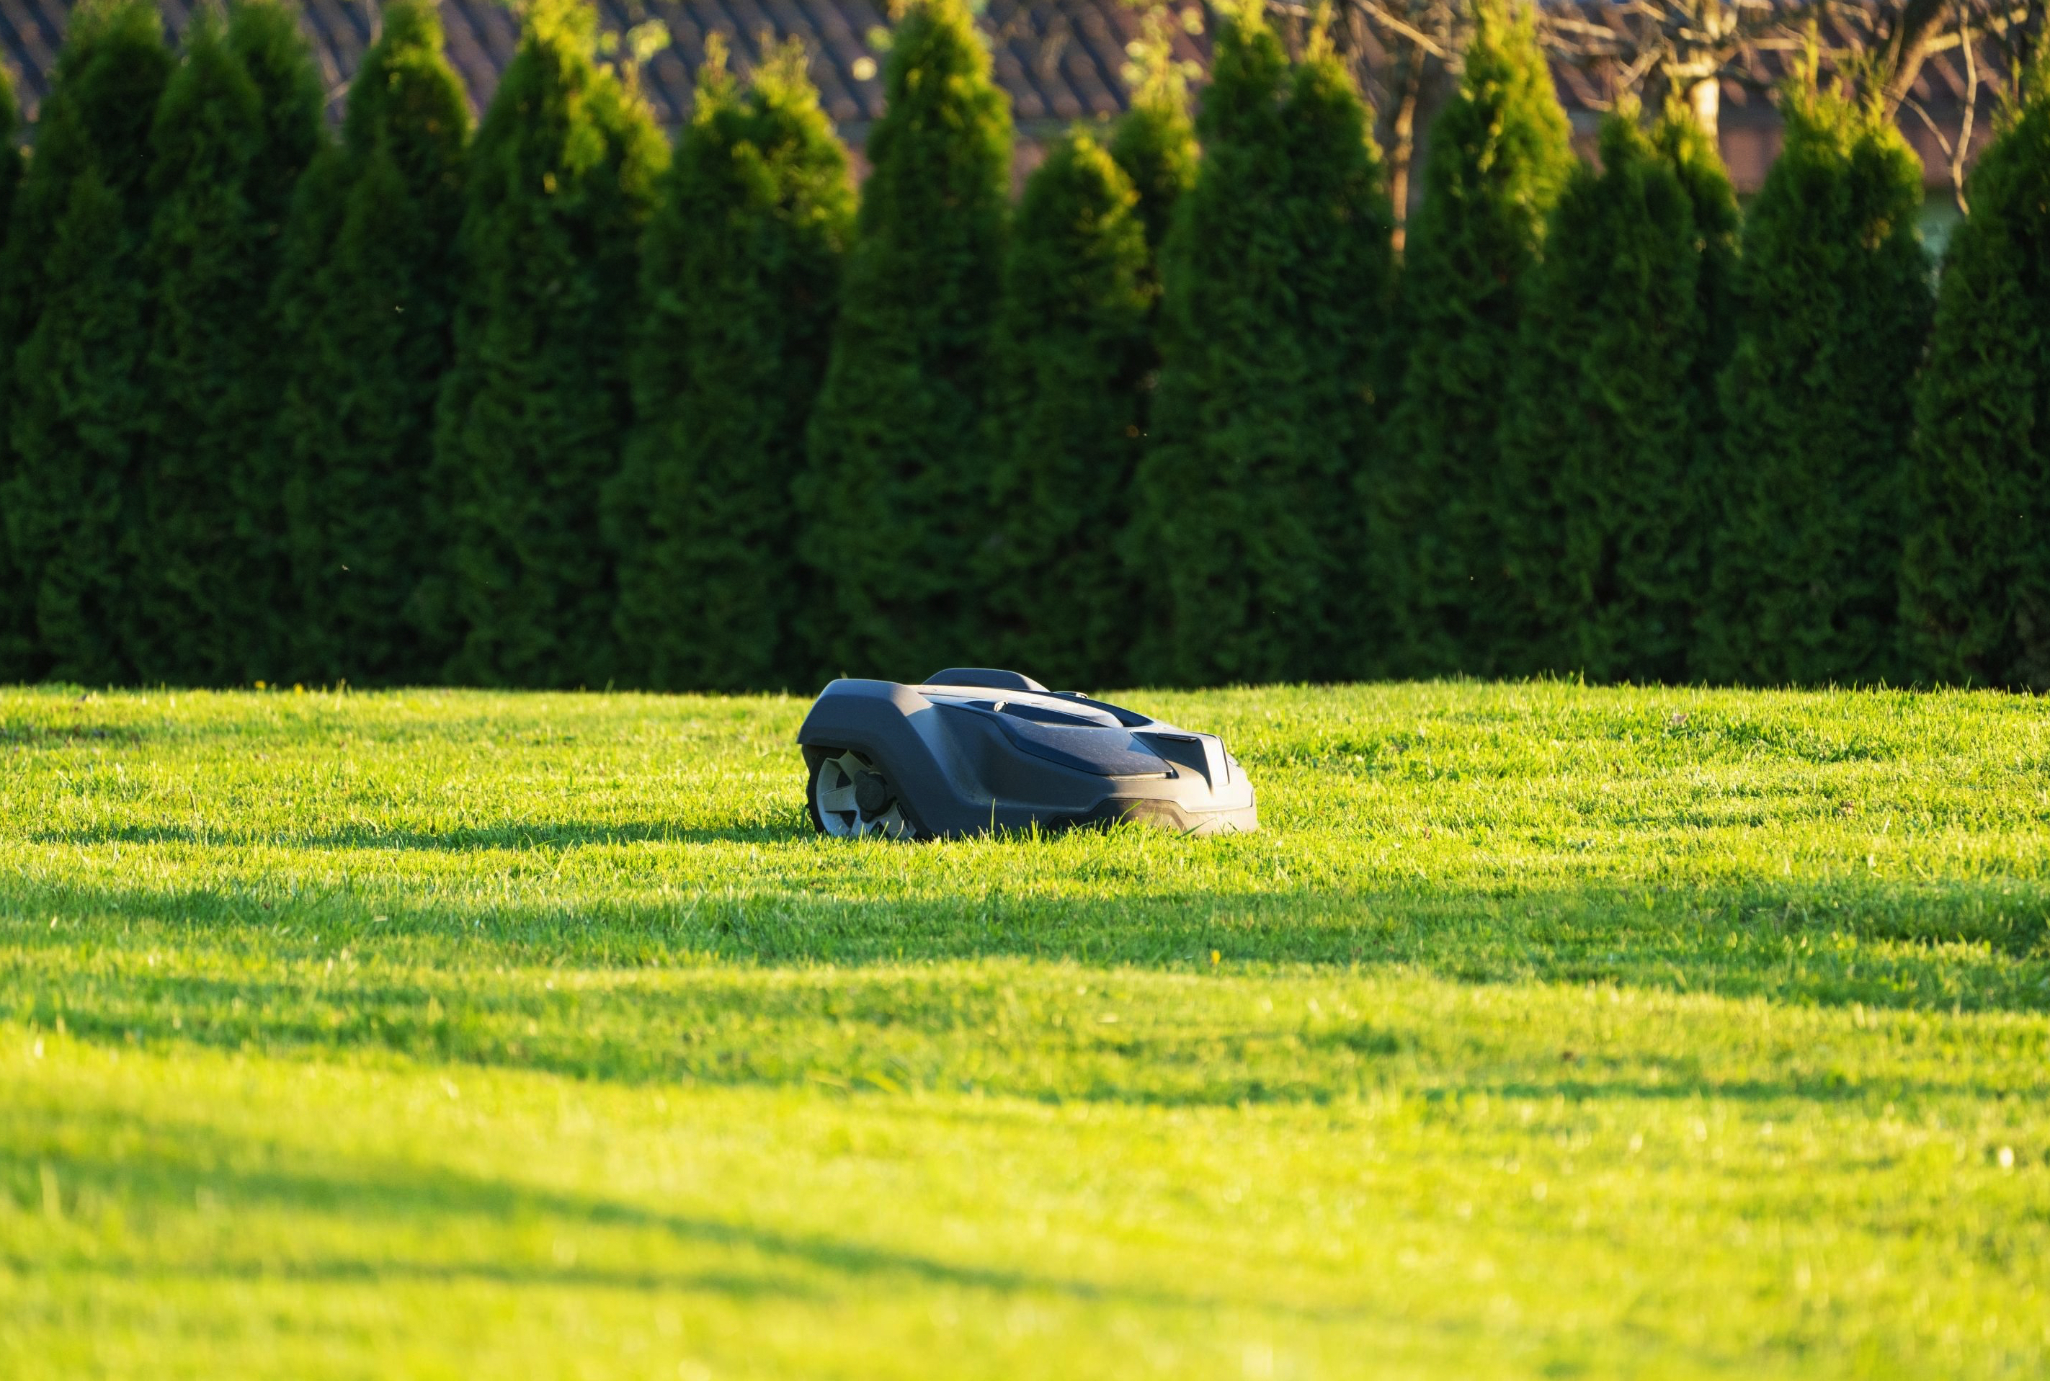
Robotics
Horticulture Applications
Robotic lawn mowers
Notes:
Similar to the robotic household vacuum cleaners that are autonomous and clean the floors, there are autonomous robotic lawn mowers. These robots can be programmed to mow based on specified conditions, without any need for human supervision.
In this clip, the student will learn about robot lawn mowers and the general practices and operation of the equipment.
Video to Watch: Robotic Lawn Mower Video (1:49)
https://www.youtube.com/watch?v=t415Y8YkSd4

Slide 13
Robotics
Notes:
The next slide (#14) provides examples of Pros and Cons of robotic use and implementation into horticulture and plant science fields. But before going to that slide, there is an opportunity for a class activity.
Class Activity: In a group or pair share, take X amount of time to brainstorm different Advantages and Disadvantages to robotic use in a horticulture industry setting.
When they come back to the larger class, can have them list on the board.

Slide 14
Robotics
Pros
Labor savings!
Plant hundreds more per hour compared to hand labor
Pick products 24/7
Can be operated by one (or few people)
Can perform risky tasks with less concern
pesticides for example
Cons
COST (initial investment)
Applicability/Feasibility (e.g. non-flat lawn for lawn mower robot)
Challenges if breaks down
Fixing timeline
Costs
Could be hard to get manual labor to fill in
Notes:
Here are several considerations, pro and con, to having or integrating robotics into a horticulture system.

Slide 15
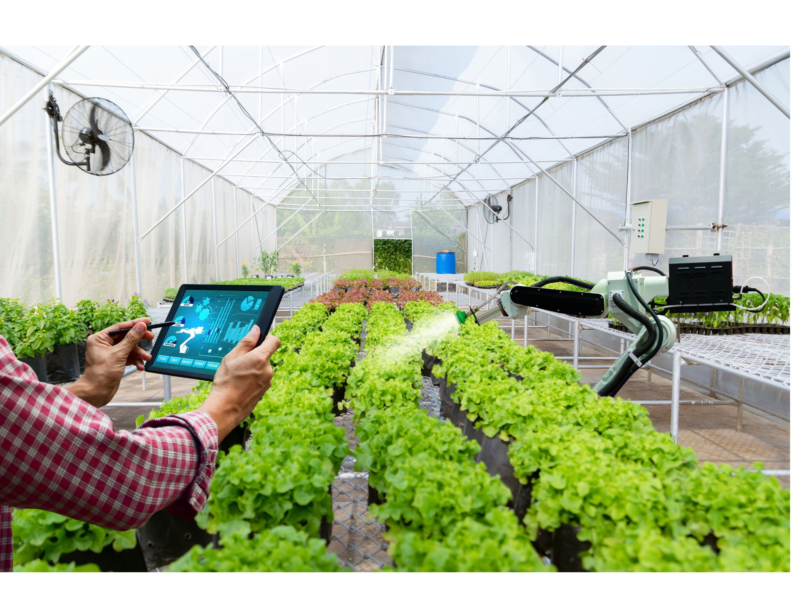
Robotics and Careers
Career Examples
Landscape Crew Leader
Plant Production Specialist
Notes:
There are exciting advances in robotics in horticulture and agriculture, and many indicate that training and understanding of robotics will be highly valued. There are many careers that will provide someone with the opportunity to operate and interact with robots and robotics. Responsibilities included with these careers could range from someone deploying robots to carry out tasks, to programming and troubleshooting robots and robotic systems.
For example: A landscape crew leader would have the opportunity to deploy, maintain, and monitor autonomous robotic lawn mowers.
An additional example of a career that could provide robotic expertise would be a plant production specialist. This specialist could be involved with robots from the very beginning of a production cycle, including, but not limited to plant cutting and propagation to planting, to plant/fruit harvest, to product packaging. There are lots of opportunities to utilize robots in the industry.

Slide 16
Project funded by:
USDA Secondary Education, Two-Year Postsecondary Education, and Agriculture in the K-12 Classroom Challenge Grant (SPECA) Award No. 2017-38414-26963

