Slide 1
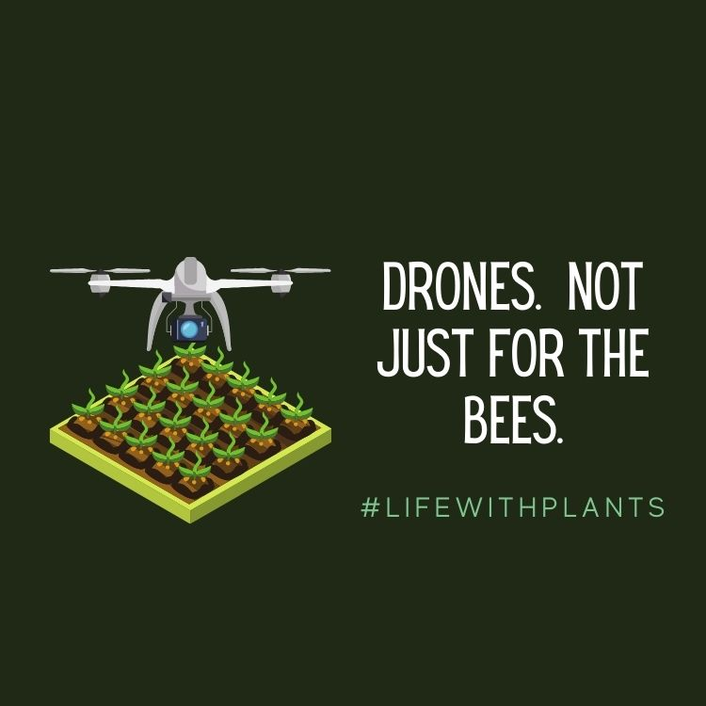

Slide 2
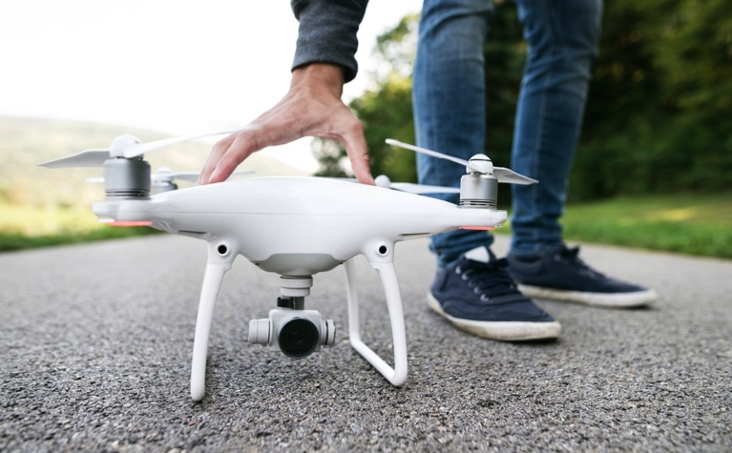
Introduction
What are Drones?
Examples of drone use in horticulture and plant science related fields
Career opportunities
Notes:
This is the class overview for drones in horticulture. We will define what drones are and better understand their use and significance in the horticulture industry. Several examples will be shared and shown. Students will also learn about different horticulture and plant science career opportunities that would include facets of drone application and use.

Slide 3
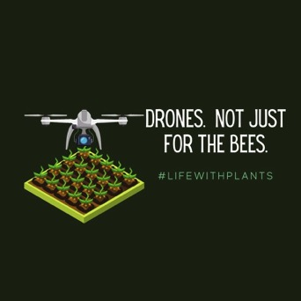
Learning Objectives
Students will :
be able to describe drones
be able to describe applications of drones in horticulture and plant science related fields
be able to evaluate a map and identify crop concerns
learn how to fly a drone***
Notes:
These are the class objectives associated with drones in the horticulture industry.
***Learning to fly a drone may be prohibitive for most instances, due to regulations. ALWAYS know the limits of drone or UAVs respective of your local, state, and federal laws.

Slide 4
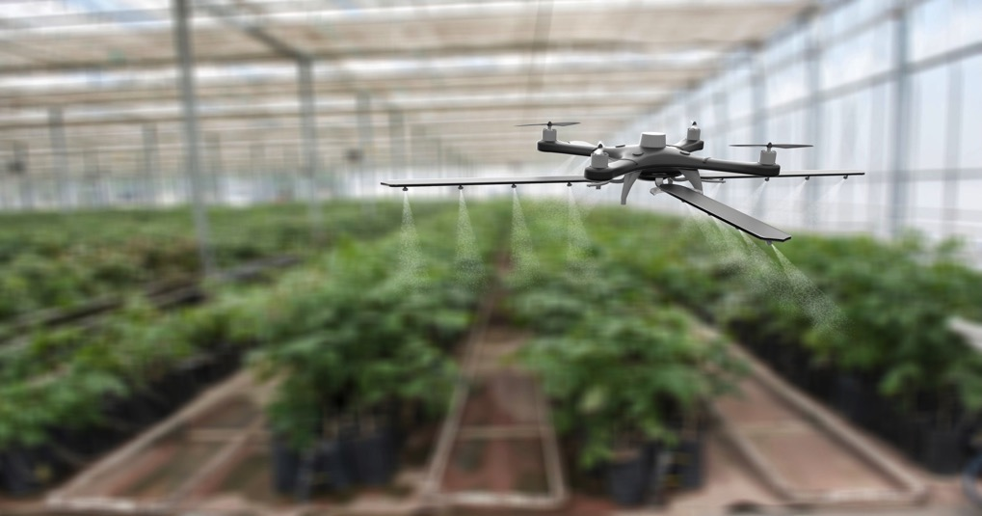
Drones
Definition: an uncrewed or unpiloted aircraft or ship, guided by remote control or onboard computers. (Merriam Webster)
Notes:
The definition of a drone: an uncrewed or unpiloted aircraft or ship, that is guided by remote control or onboard computers. Merriam Webster.
Other names for drones can be Unmanned Aerial Vehicles (UAV) or Unmanned Aircraft Systems (UAS)
Question 1: How many of you have a drone? Or maybe your family? How many have operated one? It’s very similar to a radio or remote controlled car or other toy you may have had.
Question 2: What do you think drones could be used for in agriculture or horticulture enterprises?

Slide 5
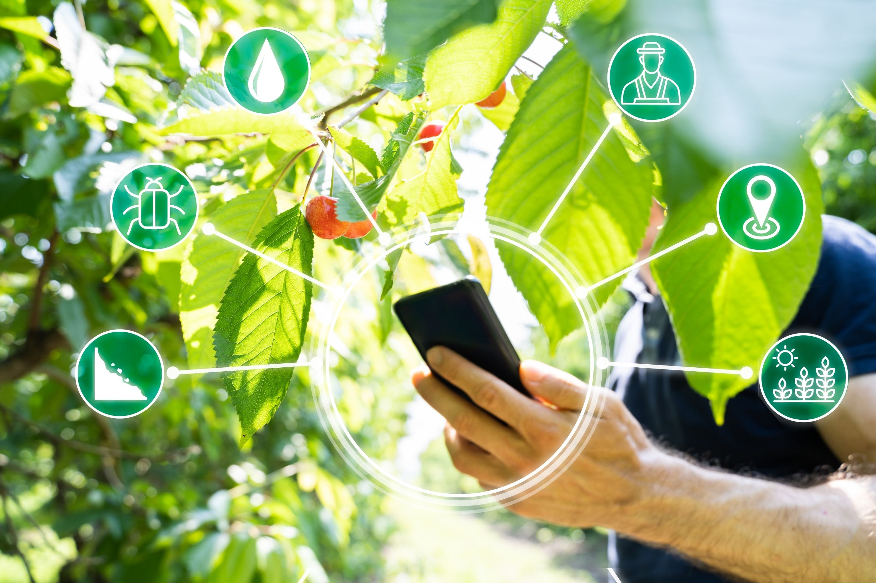
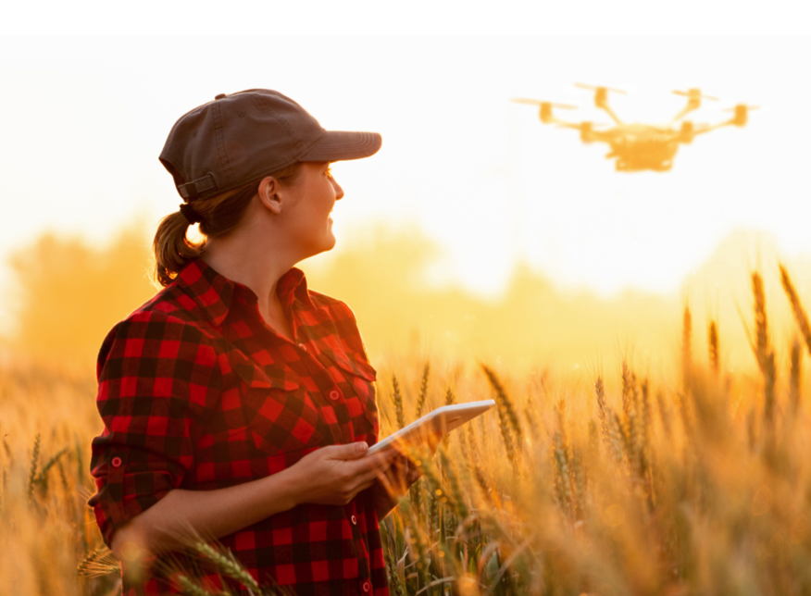
Drones
Horticulture Applications
“Smart Agriculture”
Precision Agriculture
Notes:
Drones lend themselves well to the concept of “Smart Agriculture” and precision agriculture. Drone use in agriculture practices allow for improving crop productivity, can assist in reducing pollution and reducing costs associated with crop analysis and crop inputs, such as pesticide or water applications.
Video to Watch: What is the Buzz about Drones? (42:18)
https://www.youtube.com/watch?v=uumAVdEv_j8
**This video is lengthy and very comprehensive about drones and drone applications. An instructor may wish to only share clips that may be most pertinent to the overall lesson plan.

Slide 6
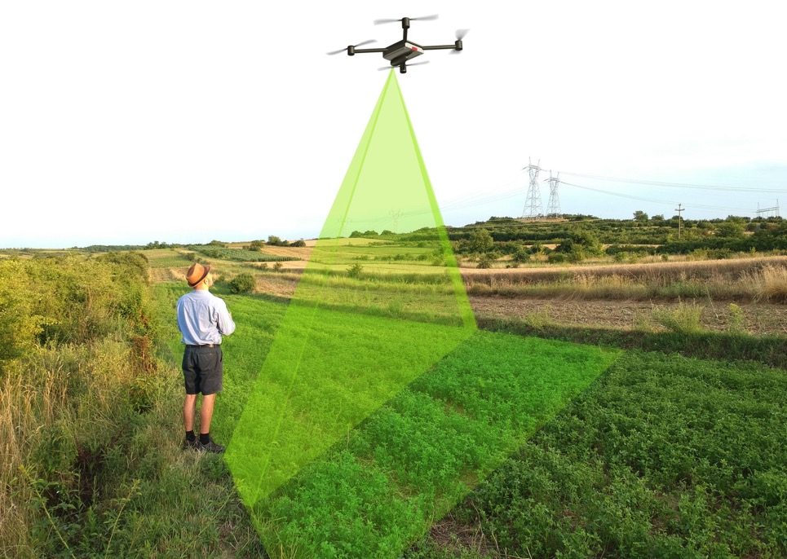
Drones
Horticulture Applications
Plant or Crop Health
Notes:
Drones and UAVs can be used to help the crop grower on the ground gather important information from above and from angles that are typically not easily performed. Direct Imaging and snap shots; can provide real time information especially in remote or not so easily accessible areas, relatively quickly. Use of different imaging systems (an example in the next slide) are beneficial for the smart or precision agriculture. The use of drones can help to identify the beginning of pest outbreaks, in specific locations, often more quickly and easily. This can allow the grower to remediate quickly and potentially reduce costs, in terms of amount of inputs and reduction of crop loss. Video to Watch: Using Drones to Save on Pesticide Costs and Loss (4:42)
https://www.youtube.com/watch?v=qj5tODEA1-w

Slide 7
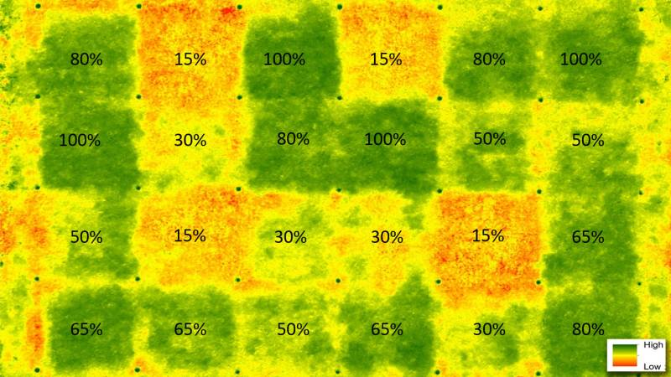
Drones
Horticulture Applications
Crop Health
Example: NDVI: Normalized Difference Vegetation Indexes
Image courtesy of:
https://www.usga.org/course-care/turfgrass-and-environmental-research/research-updates/small-unmanned-aircraft-systems-detect-turfgrass-drought.html
Notes:
One application for drone use in horticulture and plant science fields is to assess crop growth and development. These applications can assist in developing precision agricultural practices. In this slide, NDVI: Normalized Difference Vegetation Index, Is a valuable way to better understand and evaluate vegetation or plant health (and land use) remotely.
The data or information gathered by the drone is essentially reading wavelengths (colors) from the plant. Essentially the more green, the better—a greener plot—means the plants are more active.
And based on the wavelengths perceived, the information can (quickly and accurately) give a grower, producer, or farmer a very good idea of how their plants or crops are growing.
Benefit: This can help them make better informed decisions as to watering, fertilizing, pesticide applications, harvesting, etc. “Smart Agriculture” or Precision Agriculture.
An activity for the class could be done, using some similar data and have the students analyze or make crop practice predictions.
Video to watch: Drone video of Rocky Ford Turfgrass Research Center Tour; Kansas State University; Dale Bremer (1:47)
https://www.youtube.com/watch?v=berOD5xMNME

Slide 8
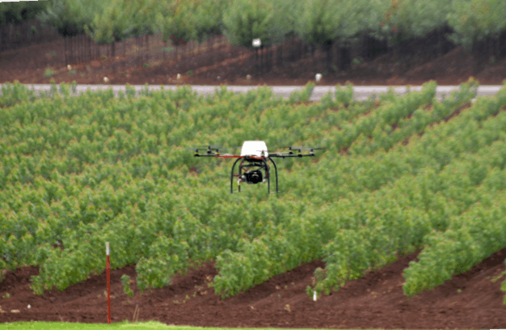
Drones
Horticulture Applications
Plant Inventory and Crop Status
Photo courtesy of: Nurserymanagement.com
Notes:
Drone use has been increasingly beneficial to nursery and field crop horticulturists. Drones can assist with plant inventories and have been shown to decrease the time needed for what can be a tedious task. Moreover, depending on the imaging methods and programs used, multiple types of data could potentially be collected during one drone launch. For example, inventory or shear numbers of plants available, but also, crop quality or any potential nutrient deficiencies, or pest problems, etc, could be analyzed at the same time.

Slide 9
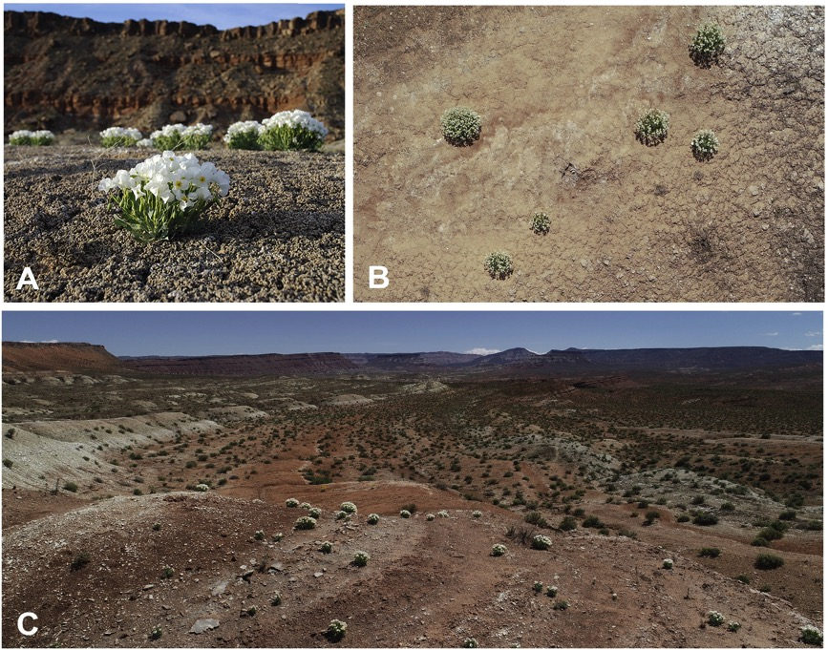
Drones
Horticulture Applications
Evaluating Plant Diversity
Understanding plant communities
(Imagery analysis)
Image credit: Science Direct; Rominger, et al., 2021.
Notes:
Plant studies on the ground can be costly and labor-intensive.
Also, some plants, especially endangered or protected plants, the habitats they are growing in, are delicate. Thus, it is more practical to observe and take data from the air if possible.
Works especially well in habitats with low vegetative cover (like in the photo).
(Source: Rominger, et al., 2021)

Slide 10
Drones
Horticulture Applications
Greenhouse Crop Monitoring
Notes:
Drones are being employed in greenhouse settings and controlled atmosphere environments, serving many purposes, including but not limited to potential pollination practices, scouting for insects and actual insect control, and general crop monitoring. Increased drone presence will be observed in the horticulture industry as this technology and drone applications are further realized.
Video to Watch: PATS Bat-like drones for Insect Control (1:41)
https://www.youtube.com/watch?v=Ua3u-h8W9l8
Video to Watch: Monitoring Food in greenhouses with micro-drones (English subtitles; 3:46)
https://www.youtube.com/watch?v=f2KxbhhXjpA

Slide 11
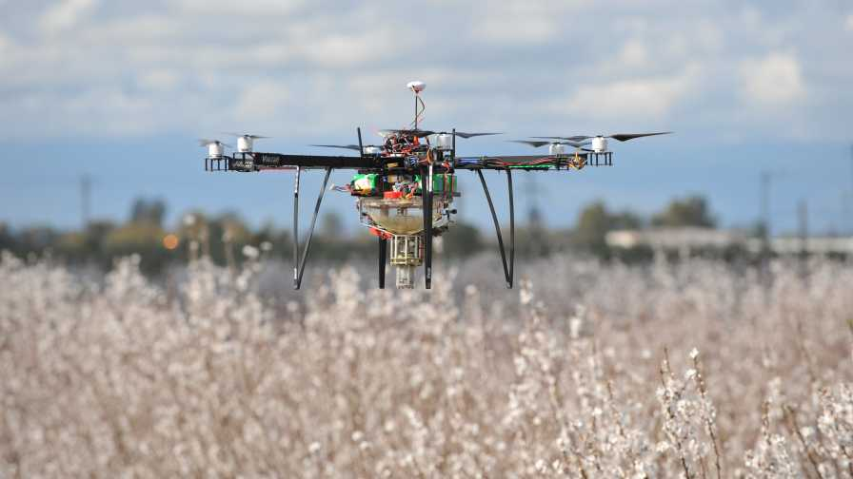
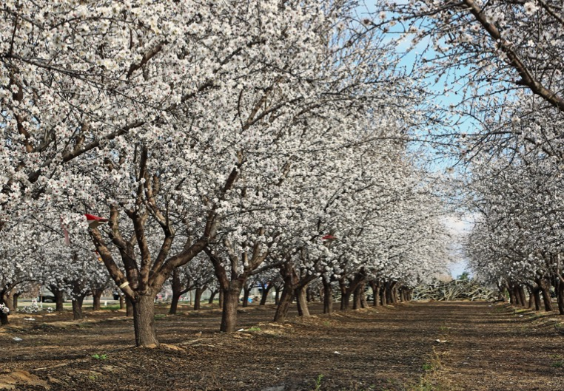
Drones
Horticulture Applications
Greenhouse and Orchard Pollination
Photo courtesy of Dropcopter
Pollen source
Notes:
Drones have been developed and modified to assist in pollinations. The drones have been employed in the outdoors in orchard systems, in which the drones can fly over receptive flowers and drop pollen from the pollen ‘catch’.
Drones are also being used and researched in protected environments to assist with crop pollination. In protected environments, there can often be deficiencies in two methods used by plants for pollination (that hopefully leads to fertilization and then fruits): wind and insects (bees for example). The drones can hover and create wind, like described in the video below, and/or they could function to drop pollen, like that described above in an orchard. In both cases, this can help to increase potential yield in the protected environment.
Video to watch: Scientists Use Drones to Artificially Pollinate Strawberries (1:01)
https://www.youtube.com/watch?v=lZJMgTgXRGU

Slide 12
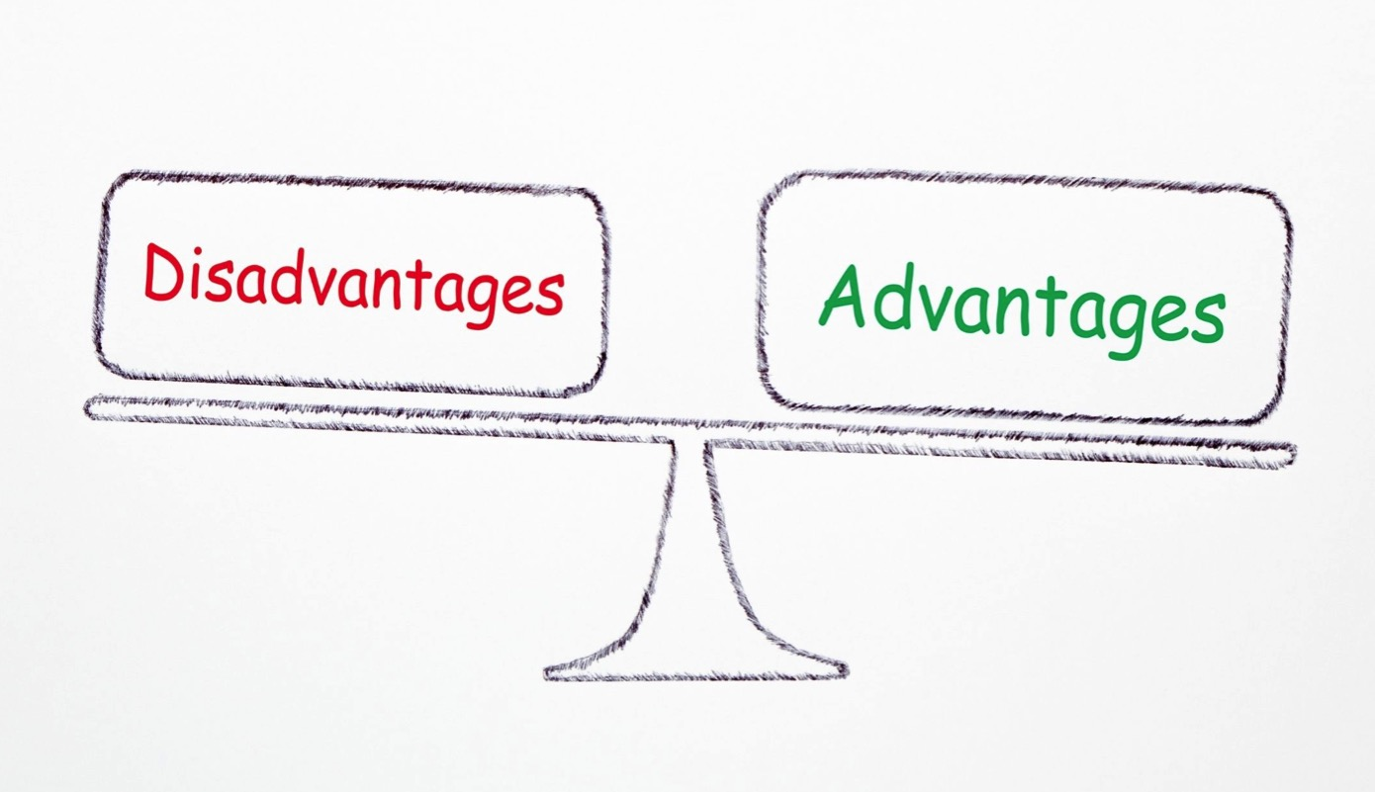
Drones
Can you think of….
Notes:
The next slide provides examples of Advantages and Disadvantages of Drone use and implementation into horticulture and plant science fields. But before going to that slide, there is an opportunity for a class activity.
Class Activity: In a group or pair share, take X amount of time to brainstorm different Advantages and Disadvantages to drone use.
When they come back to the larger class, can have them list on the board.

Slide 13
Drones
Advantages
Saves labor!
Can be operated by one (or few people)
Less intrusive practices for some situations
Can improve efficiency
Disadvantages
Cost! (initial investment)
Depends on quality/model
Certification/Training
Challenges if breaks down
Fixing timeline
Costs
Could be hard to get manual labor to make-up
Notes:
This slide presents both some advantages and disadvantages of drones and drone use in the industry.
Many of these advantages/disadvantages can be described or related to each of the drone examples in previous slides.

Slide 14
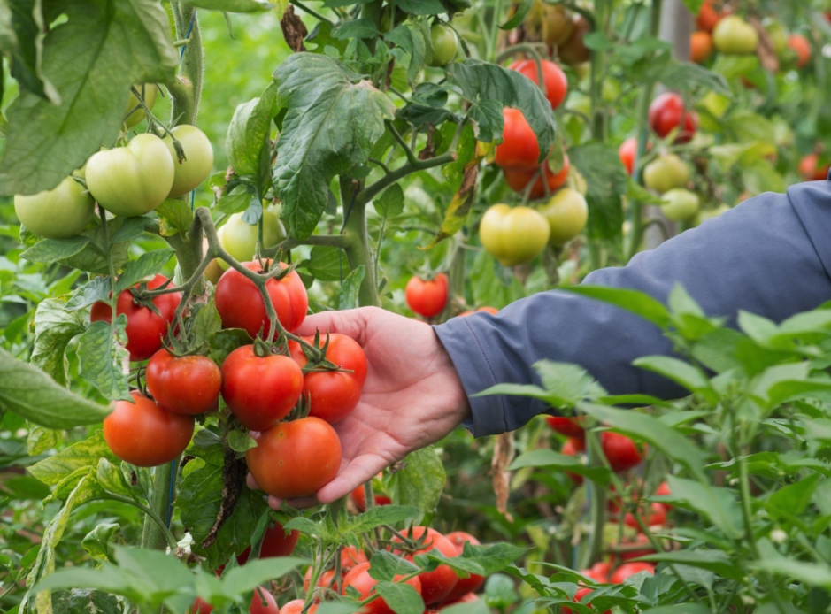
Drone Careers
Career Examples
Greenhouse Tomato Grower
Orchard Manager
Ecologist
Notes:
The future for drones is quite positive and exciting. As drones and drone use continue to increase in agriculture and the horticulture industry, additional jobs and careers using and employing drones will become available and necessary. Moreover, these technologies can assist in our efforts to mitigate and adapt to the changing climate, along with increasing population.
Greenhouse tomato grower: Use of drones for pollination. The vibrations from the drone could mimic the vibration or buzz from bees, and assist in pollen release.
Orchard manager: Drones could be helpful in distributing pollen for increased crop yields. These technologies could also serve to assist the grower in identifying any pest pressures, so they can be remediated in a quick and proper manner.
Ecologist: Drone use could assist in better land management and plant control or implementation, as drones could be used to inventory and assess environment changes and growth patterns.
These are just a few of the careers and professions that could include drone usage and implementation.

Slide 15
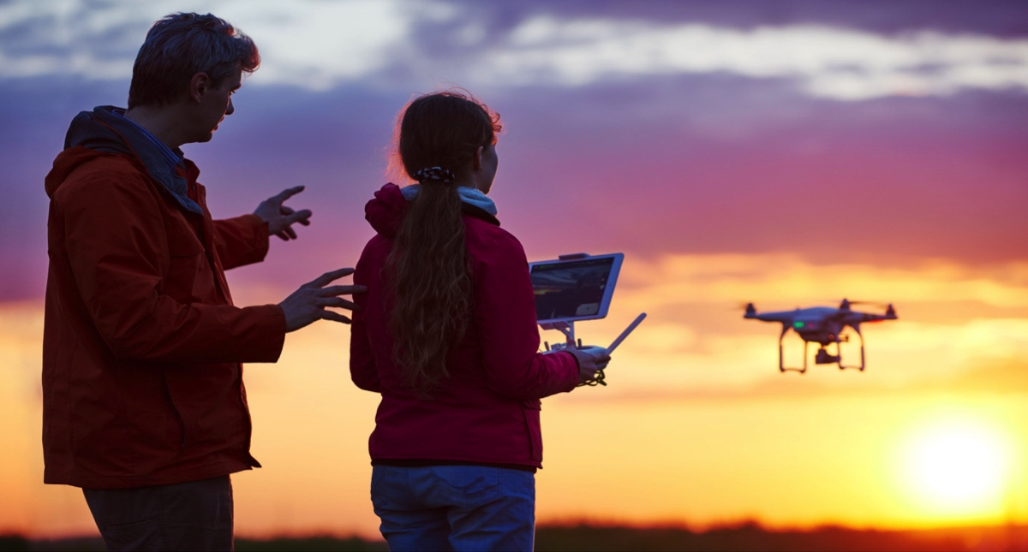
Drone Education
College Programs
Kansas State University Salina Aerospace and Technology Campus
University of Nebraska Omaha
Notes:
As described in the previous slide, the future for drones is positive and exciting. And with more implementation and drone use, there will be ample opportunities and the need for professionally trained drone operators and pilots. A couple examples of undergraduate programs that provide degree-based training include, Kansas State University Salina Aerospace and Technology Campus (https://www.salina.k-state.edu/academics/degree-options/uas-flight/) and University of Nebraska at Omaha. These are only two of the number of programs available for consideration.
As drones and drone use continue to increase in agriculture and the horticulture industry, additional jobs and careers using and employing drones will become available and necessary. Moreover, these technologies can assist in our efforts to mitigate and adapt to the changing climate, along with increasing population.

Slide 16
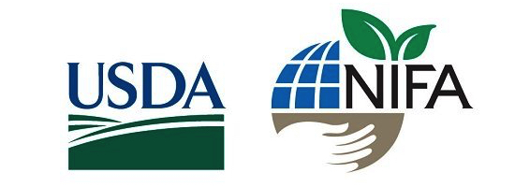
Project funded by:
USDA Secondary Education, Two-Year Postsecondary Education, and Agriculture in the K-12 Classroom Challenge Grant (SPECA) Award No. 2017-38414-26963

