Slide 1
Horticulture Bachelor’s Degree Program
Kansas State University
Notes:
This presentation provides insight into the horticulture program at Kansas State University. It is one example of an undergraduate horticulture program, and would be similar to other 4-year, land grant institutions across the United States. This presentation would be a good follow-up presentation to the Careers in Horticulture PowerPoint.

Slide 2
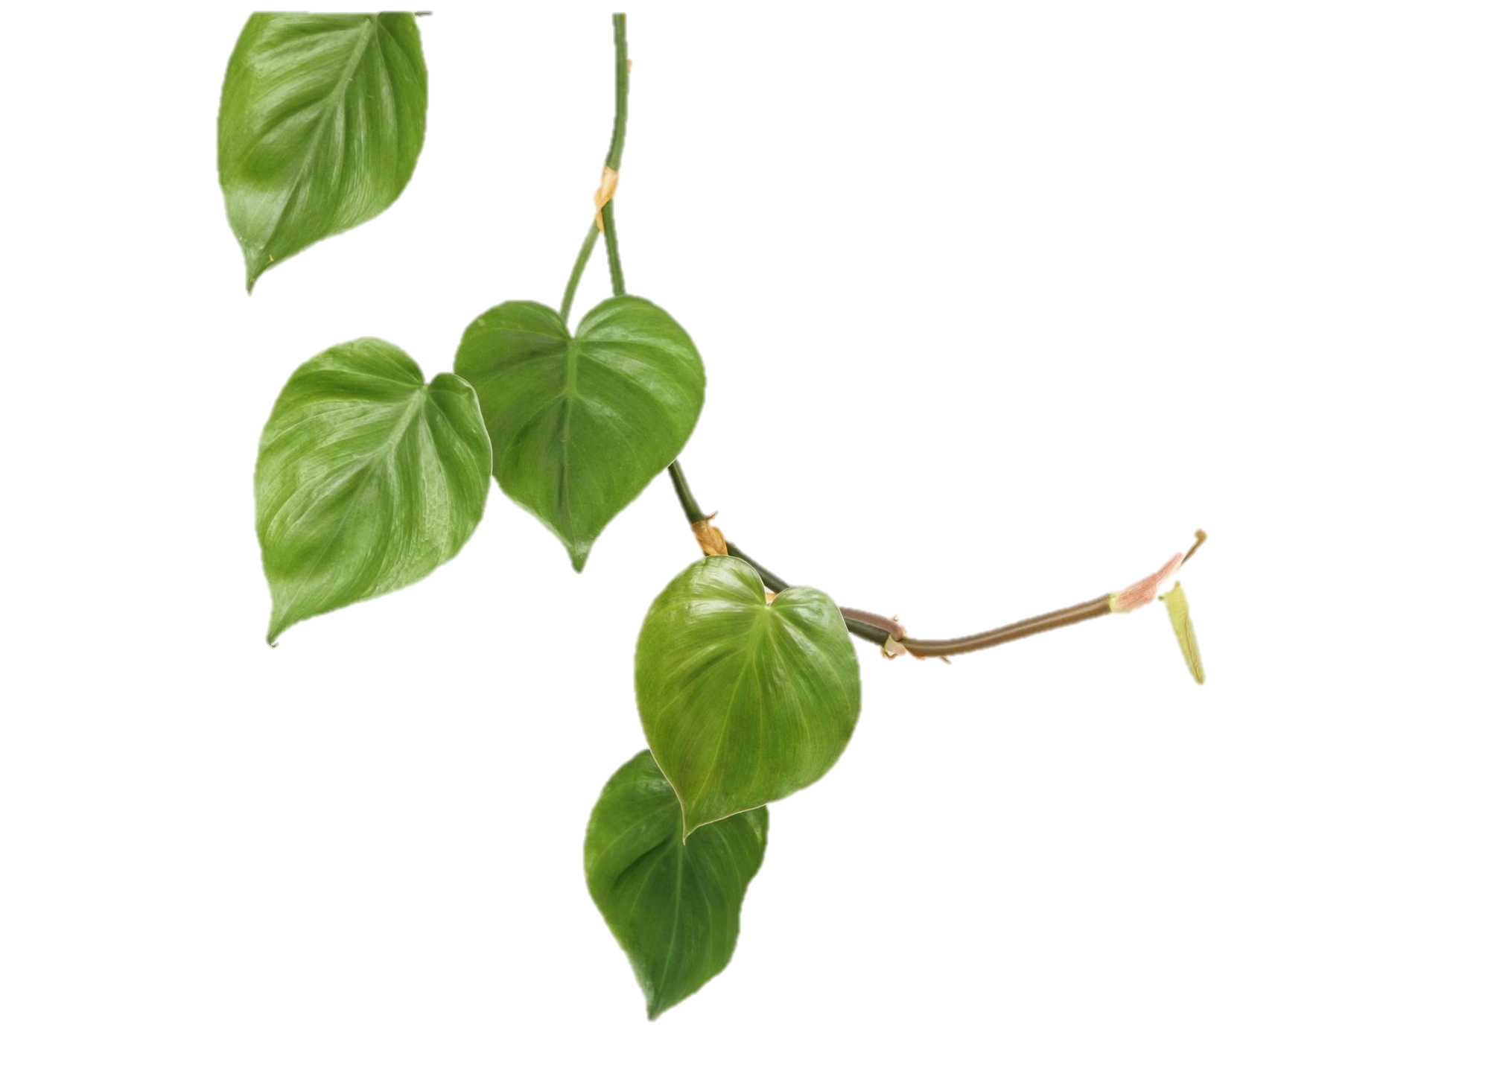
Learning Objectives
Students will :
Be able to describe the programs options in a university horticulture bachelor’s program; Kansas State University as an example
Notes:
After this presentation, the primary learning objective will assist students in knowing opportunities of an undergraduate bachelor’s degree program at a 4 year institution (Kansas State University).

Slide 3
When considering a profession…
Would you prefer to be…
Working outdoors?
Working indoors?
Horticulture and Plant Science career opportunities for you!
Horticulture and Plant Science career opportunities for you!
Notes:
Question: Would you prefer a job outside or outdoors? A job indoors? Both options provide opportunities in horticulture and plant science. There are dozens of career options for people interested in plants and the outdoors or plants and the indoors. And for those that appreciate working with people, many careers that offer that as well!

Slide 4
K-State Horticulture Program
Horticulture Bachelor’s Degree
at Kansas State University
Specialization Areas
Landscape Horticulture
Production Horticulture
Horticulture Science
Golf Course and Sports Turf Operations
Major Goals for our teaching, research, and extension programs
sustainable production of horticultural food and specialty crops
identification of turf and ornamental landscape plants and management practices that conserve water and reduce other resource inputs
improved plant resistance to environmental stresses
augmentation of health-promoting phytochemicals in food crops
enhanced post-harvest handling and microbial safety of fresh produce
Notes:
The information in this presentation provides insight and information regarding a bachelor’s degree program in horticulture at Kansas State University.
In the Horticulture and Natural Resources Department, there are four tracks or specialization areas students can choose from.
Those specialization areas focus on the themes to the list of goals and programs noted on the right-hand side of the slide.
Video to Watch: Former undergraduate student, Renata Goossen: Why she chose horticulture.
https://www.youtube.com/watch?v=oywy64N_5dQ

Slide 5
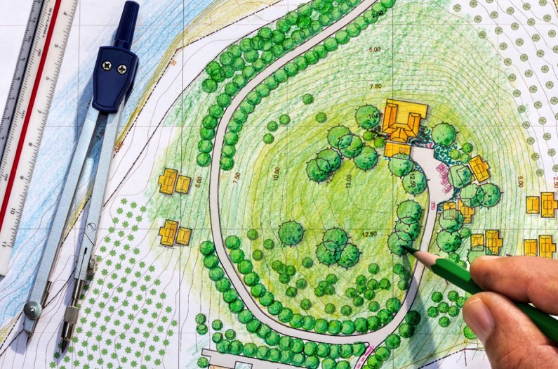
K-State Horticulture Program
Landscape Horticulture
Landscape design courses and experiences
Notes:
One specialization area for students to consider is the landscape horticulture. Opportunities abound in the landscape profession, from design and construction/installation through maintenance of commercial and residential landscape environments. This specialization is a perfect marriage of art and science and is ideal for people who enjoy being outdoors and working with a wide variety of plants and people. It includes business management, tree and shrub care, flower bed installation, designing and trouble-shooting irrigation systems, and landscape construction projects. Students with interest in developing artistic and design skills learn to create functional and sustainable landscape environments for outdoor living. Landscape horticulturists are sought by garden centers, botanical gardens, tree care, landscape maintenance and installation firms, nurseries, and governmental bodies. Private consulting is also a possibility. Many of these careers involve consumer relations and sales. Graduates are highly employable by professional firms nationwide.

Slide 6
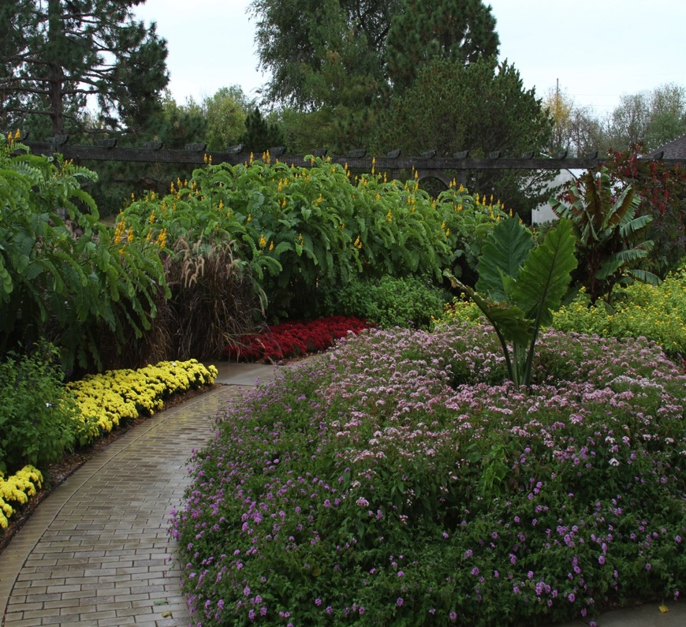
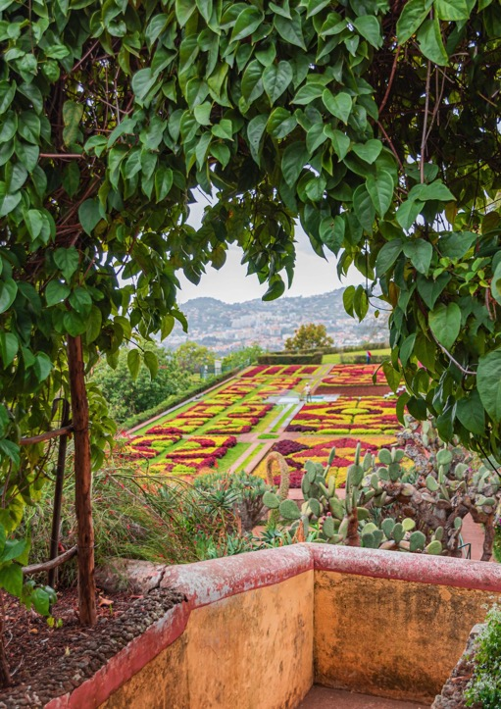
K-State Horticulture Program
Landscape Horticulture
Experience with Ornamental Horticulture
Botanica in Wichita, KS
Notes:
In addition to the topics noted, (landscape design, to landscape maintenance, learning about irrigation systems, to learning about and maintaining trees), students will have gain exposure and engagement with general ornamental horticulture, including public gardens and ornamental horticulture and plant science practices. The K-State program does not have a specific “public” horticulture focus, but aspects of that horticulture area are infused throughout other courses and activities.

Slide 7
K-State Horticulture Program
Landscape Horticulture
Landscape maintenance and irrigation installation
Notes:
As briefly noted before, one area of landscape horticulture that students will experience is the topic and area of landscape maintenance. This includes aspects of turf and ornamental management, upkeep, and installation practices. Students engage in courses and content that relates to plants and the landscape. This can be everything from learning landscape design, to landscape maintenance, learning about irrigation systems, to learning about and maintaining trees.

Slide 8
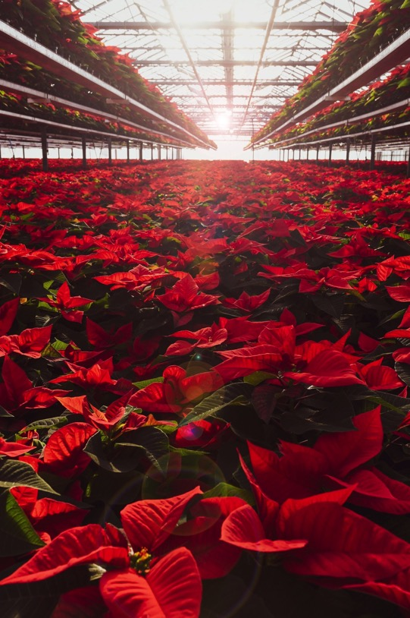
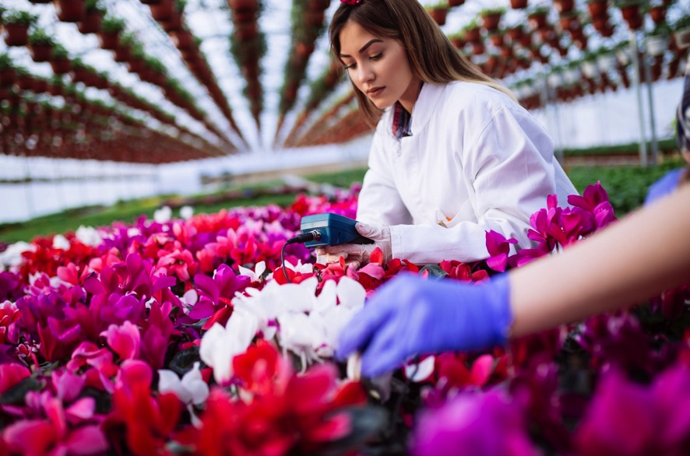
K-State Horticulture Program
Horticulture Production
Floriculture and Plant Production
Notes:
A second, and popular specialization area of the program is horticulture production. An education combining horticulture and business courses prepares students for opportunities in propagation and production of potted crops, bedding plants, trees and shrubs, cut flowers. This program also prepares students for careers in organic, sustainable, and conventional fruit and vegetable production, along with specialty crops, including hemp. Many students obtain professional positions as greenhouse, nursery, or garden center managers or with allied trades such as seed breeding companies, supply firms, research greenhouses, retail floral shops, and wholesale brokers. Employment opportunities also include owner or manager of a fruit or vegetable farm; organic farmer; or work with non-profit organizations in the new area of urban and community gardening. Graduates would also be qualified to be field representatives for processing, agricultural input suppliers, or equipment companies; or as managers, buyers, field representatives, or produce brokers/marketing representatives. Our greenhouses and student educational farm allow students to get hands-on experience in many of these areas in addition to course-work and field trips.

Slide 9
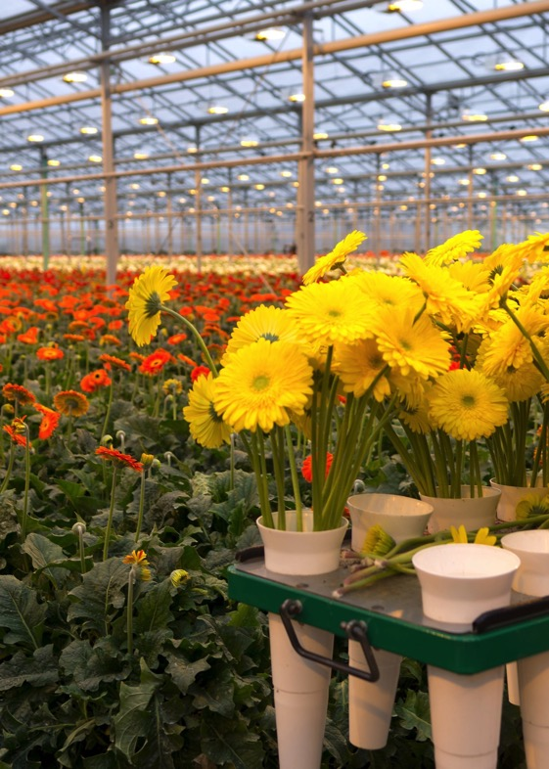
K-State Horticulture Program
Horticulture Production
Floriculture, Cut Flowers, and Floral Design
Notes:
Included in the curriculum for horticulture production are opportunities to learn about floriculture and plant production. This includes typical floral crops, poinsettias as a potted plant crop example and cutflowers, such as alstroemeria. There are also opportunities for students to learn and gain floral design experience from a certified floral designer.

Slide 10
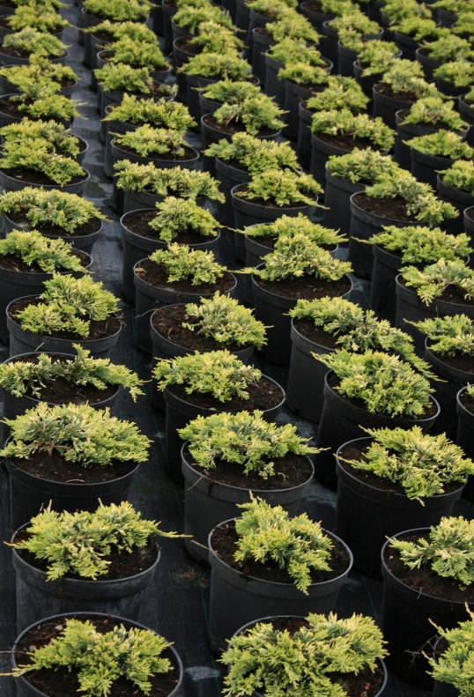
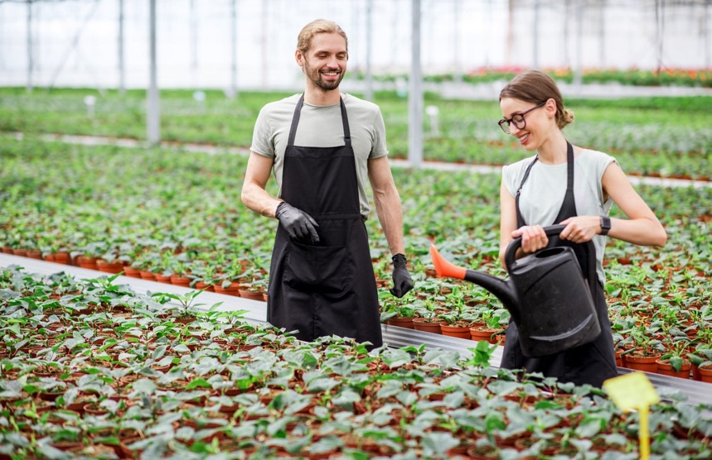
K-State Horticulture Program
Horticulture Production
Greenhouse and Nursery Production
Notes:
Students get hands-on production experiences in the K-State greenhouses, including herbaceous crop production and floriculture crop production. Students can also experience growing facilities that produce nursery (trees, shrubs, perennials) crops as well.

Slide 11
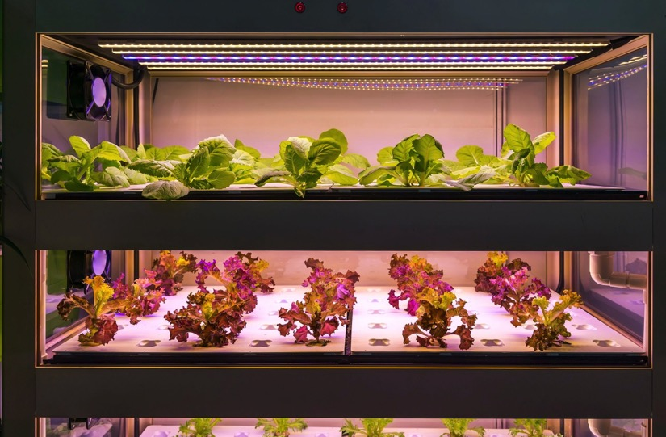
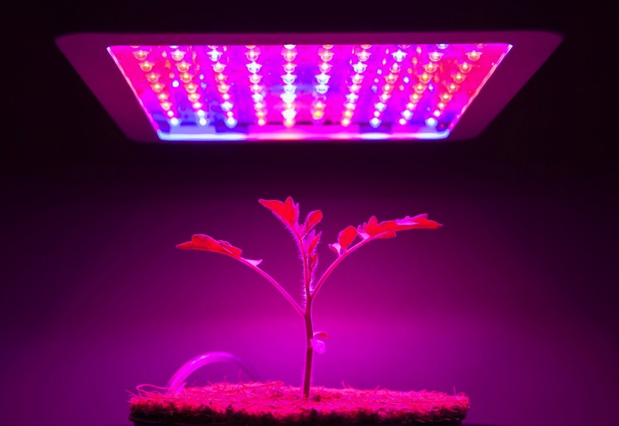
K-State Horticulture Program
Horticulture Production
Technology—Food Production and LED lighting
Notes:
Included in the horticulture production courses, laboratories, along with experiences through field trips and site visits, students will learn about innovative and current production practices that optimize and enhance crop production, especially in protected environments. Included in this are courses and topics that focus on urban agriculture and food production, coupled with technologies that have been increasingly developed and implemented in the industry, such as LED lighting techniques.

Slide 12
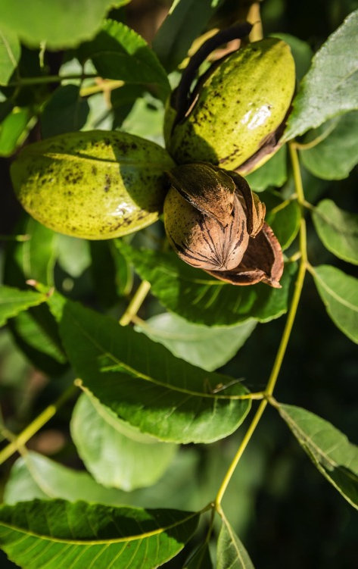
K-State Horticulture Program
Horticulture Production
Fruits, Vegetables, Nut Crops
Notes:
The horticulture production program covers a wide variety of crops and prepares students for a wide variety of careers in the horticulture and plant science industry.

Slide 13
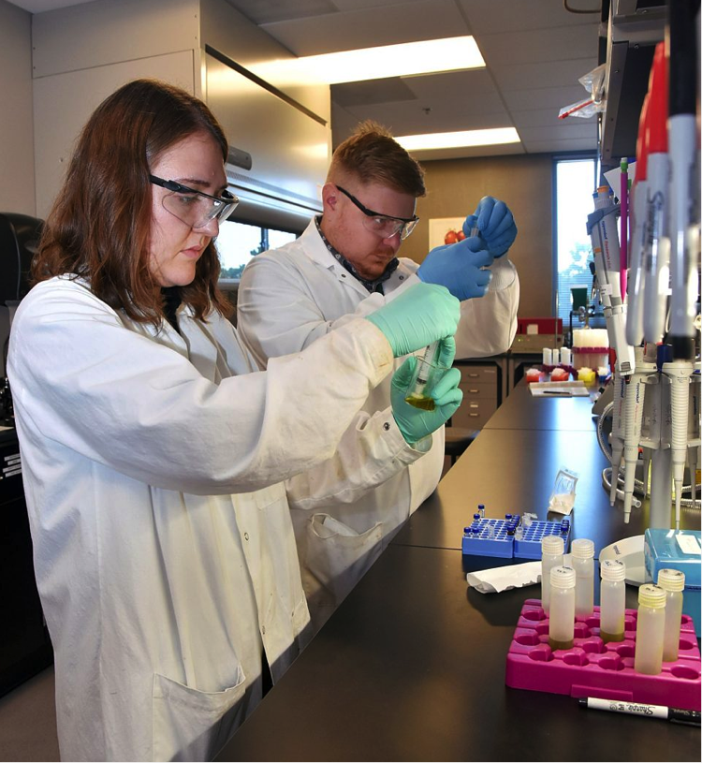
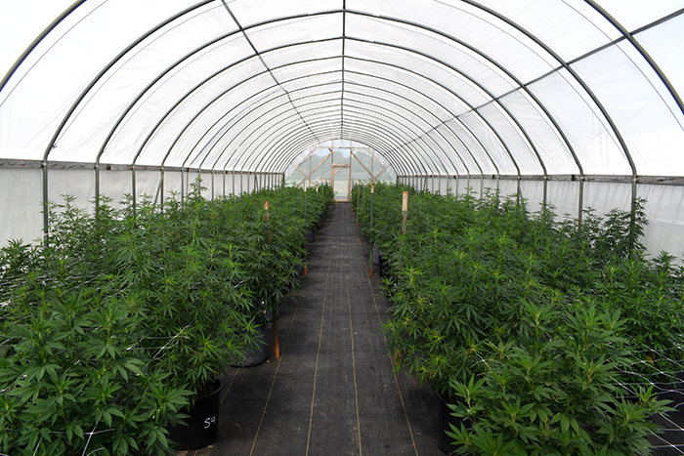
K-State Horticulture Program
Horticulture Production
Hemp
K-State Olathe
Notes:
A specialty horticulture crop that is gaining importance is hemp and hemp production. Students will have the opportunity to learn about the crop, from production to post harvest and chemical properties of the crop.

Slide 14
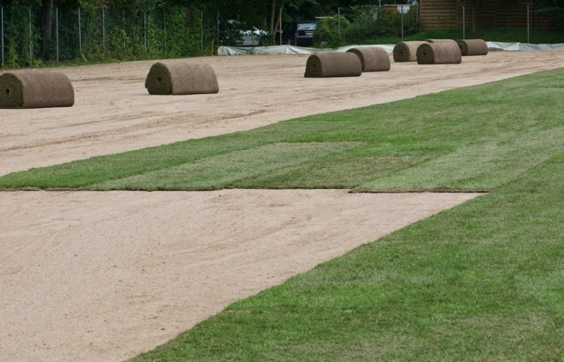
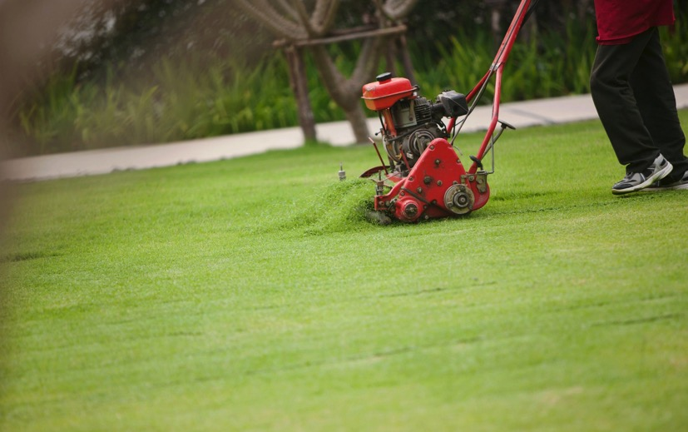
K-State Horticulture Program
Golf Course and Sports Turf Management
Turfgrass courses and industry experiences, both local and nationally
Notes:
A third specialization area in the horticulture and natural resources department is golf course and sports turf management. This program is designed to prepare for rewarding careers as the next generation of golf course superintendents and managers, and as turf managers for professional sports organizations, school districts, colleges and university grounds departments, and municipal park and recreation departments. The unique curriculum combines courses in business, communications, hospitality, and turfgrass management, along with two internships. Graduates are employed by golf courses, golf clubs, and other sports facilities all over the U.S. and world, as well as in industries allied to golf and turfgrass management.
Video to Watch: Golf Course Turfgrass: This is my office. (1:21)
https://www.youtube.com/watch?v=mO8oawPns3E&t=12s

Slide 15
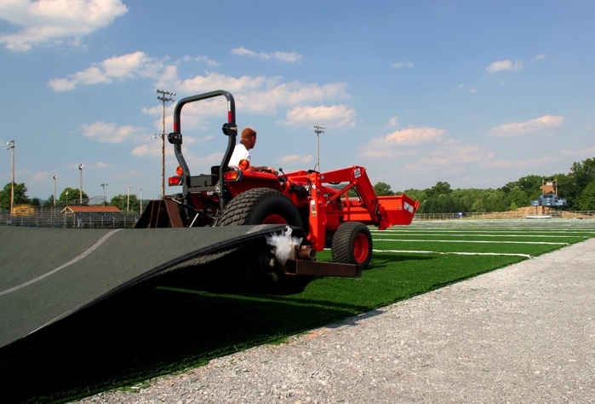
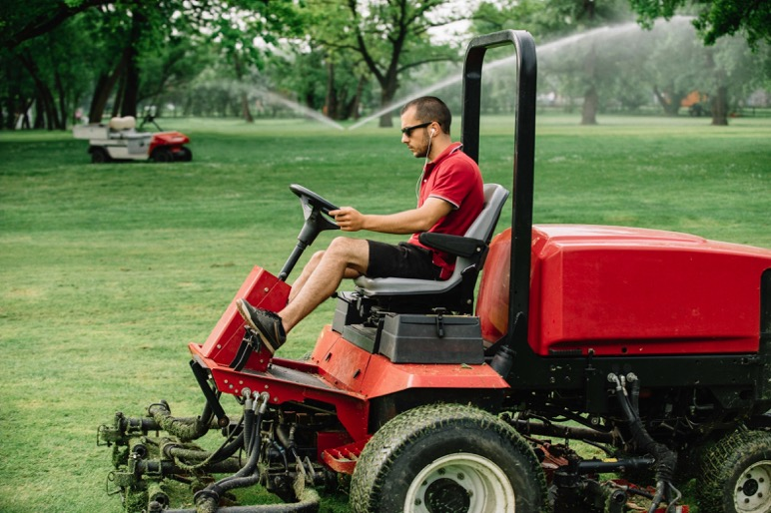
K-State Horticulture Program
Golf Course and Sports Turf Management
Experience in sports turf areas, including courses and local and regional exposure to professional sports venues
Notes:
Students will gain hands on experience, not only through two required internship experiences, but also through several lab-based courses. Students get to experience sports turf examples, locally, and regionally, including professional sports venues.

Slide 16
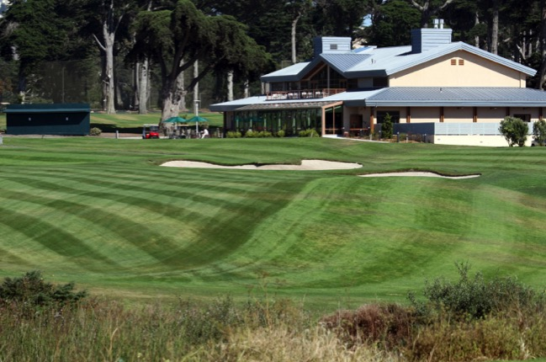
K-State Horticulture Program
Golf Course and Sports Turf Management
Significant focus on business, hospitality, and communications in the program.
Notes:
The curriculum and program experiences for students provides for a strong focus on business, hospitality management, and communication course work, in addition to disciplinary horticulture coursework. These courses provide a strong background for students in their future career.

Slide 17
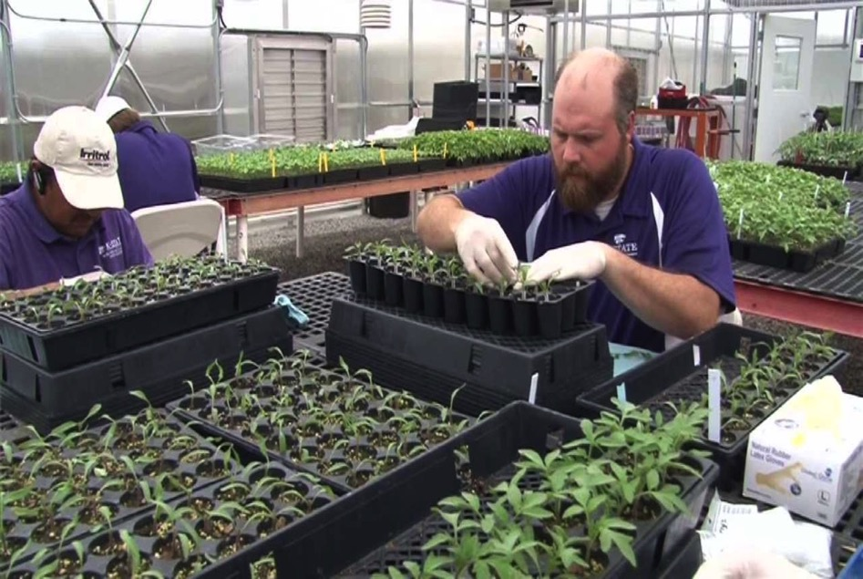
K-State Horticulture Program
Horticulture Science
Science and research focused experiences
Notes:
The fourth specialization area is the horticulture science option. This degree specialization is intended for students who plan to pursue a graduate degree or would seek out a career that would have more research based activities and responsibilities. Universities, state and federal agencies, and industries need trained scientists who can teach, conduct research, and communicate research findings to the public to increase the production and effective use of horticultural products. Many who earn the master of science degree work as consultants, technical representatives, community college instructors, and county extension agents. Those earning a doctorate degree work at universities, the USDA, and research and development for industry firms.

Slide 18
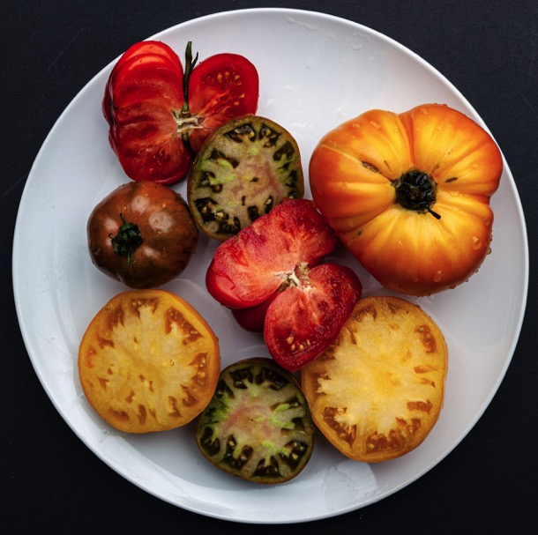
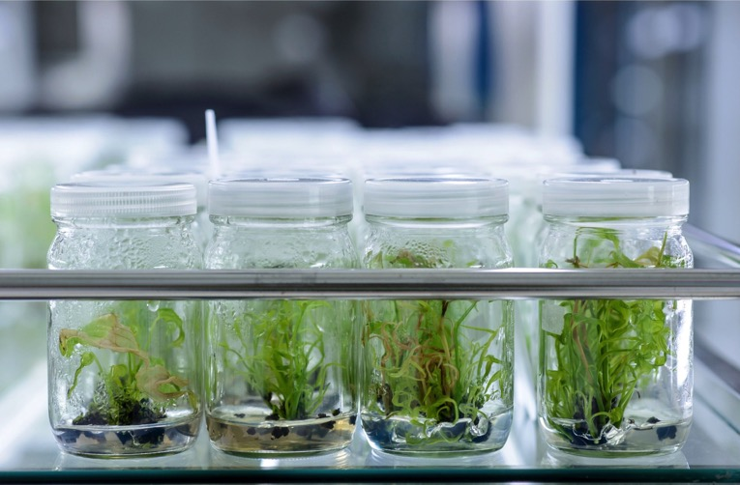
K-State Horticulture Program
Horticulture Science
Increasing the content both for health and pharmaceutical value
Lycopene in Tomatoes
Notes:
One area of research and experience students can experience is research focused on improving horticulture crops, for human health and consumption, along with developing pharmaceutical value. One example of recent ongoing research is improving lycopene content in tomatoes. Another is developing more drought tolerant and resistant crops.

Slide 19
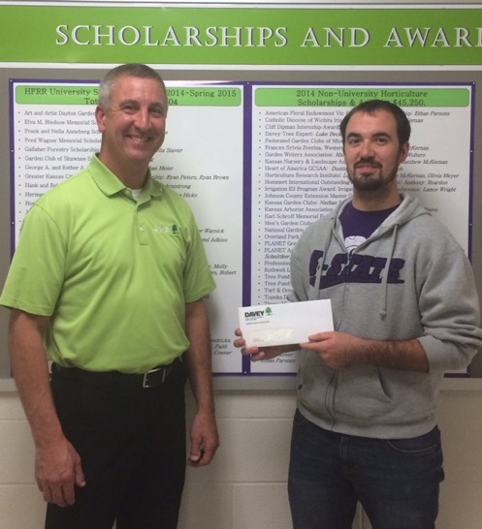
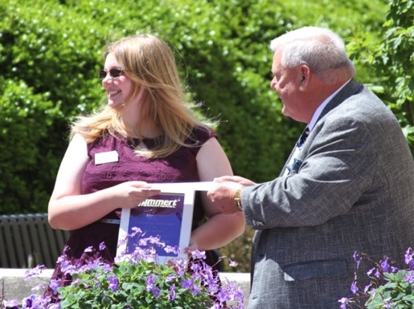
K-State Horticulture Program
Scholarships
Over $50,000 in University and College of Agriculture Scholarships in 2020
Over $90,000 in non-university scholarship sponsored by industry groups and private organizations in 2020!
Notes:
Funding a college degree is a major consideration whether or not to pursue a degree, among other factors. Students in good standing have many opportunities to secure additional scholarship monies and recognition, not only through K-State and the College of Agriculture, but also through industry and non-university based scholarships. This is in part due to the close connection faculty have with the industry and the strong interest and desire of the industry to support the future industry leaders!

Slide 20
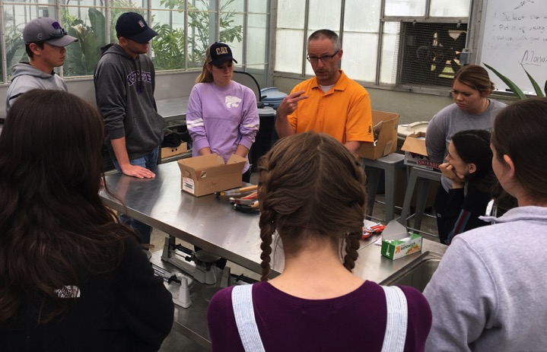
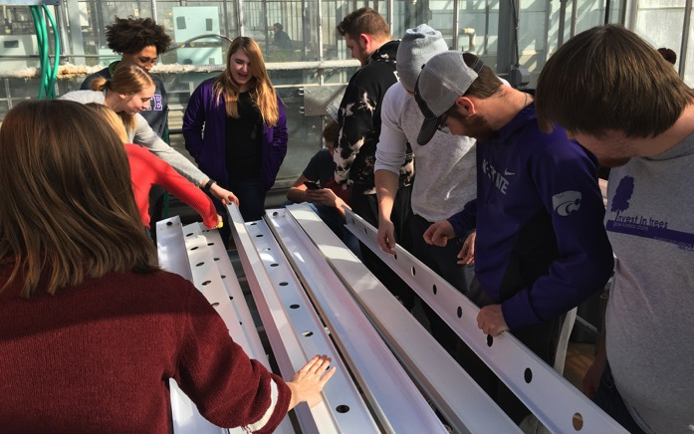
K-State Horticulture Program
Department Highlights
SMALL Classes and Laboratory Settings
Faculty to Student Ratio: 17:1
Notes:
The department is proud of the ability to have smaller course lecture and laboratory sizes. This small student to faculty ration provides more one on one and individual experiences for the students. It is typical for the faculty to get to know all of the students in class and lab and are able to closely connect and assist students in their degree program goals.
.

Slide 21
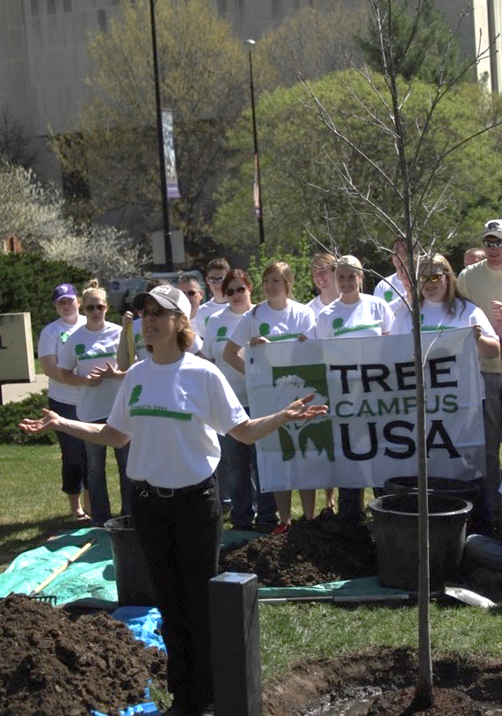
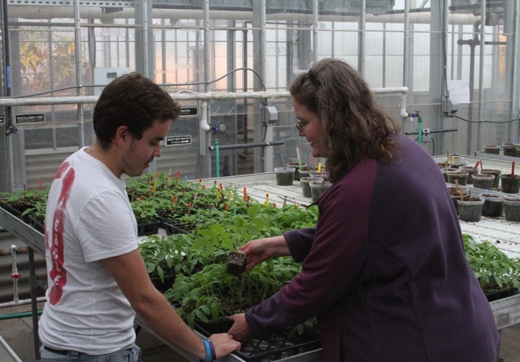
K-State Horticulture Program
Department Highlights
Award Winning Faculty
Local, State, Regional, National, and International recognitions
Notes:
The department has a strong tradition and focus on providing some of the best classroom experiences for the students. The faculty care about students and student learning and with that, are constantly improving, modifying, and enhancing the curriculum presented in class and in the laboratories. With that, the faculty in the department are recognized at K-State, in the region, nationally, and also internationally.

Slide 22
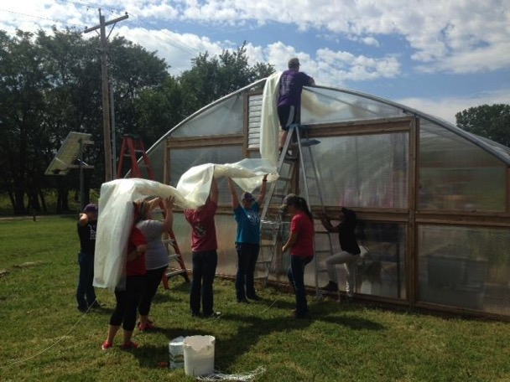
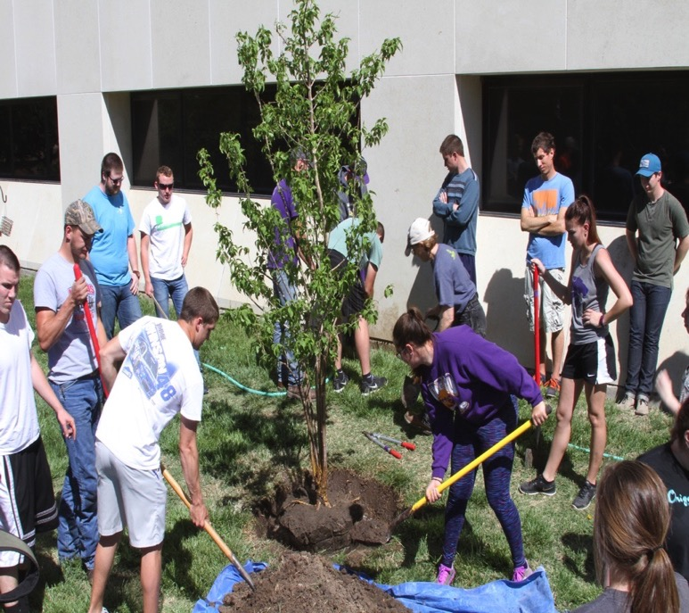
K-State Horticulture Program
Department Highlights
Real-world, hands-on, practical experiences
Notes:
Whether through classes or student clubs, or job and internship opportunities, students can expect to get significant real-world, hands-on practical experiences. This happens both on campus and off campus. All students are required as a part of their degree program, to participate in one formalized internship experience. Students in the golf course and sports turf specialization, will do two formalized experiences. Faculty (and industry members) highly encourage students to get a diverse work experience, as that will be valuable experience to assist them in navigating their professional career.

Slide 23
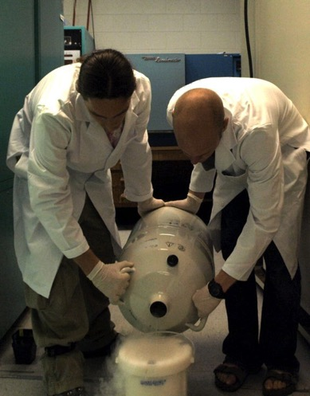
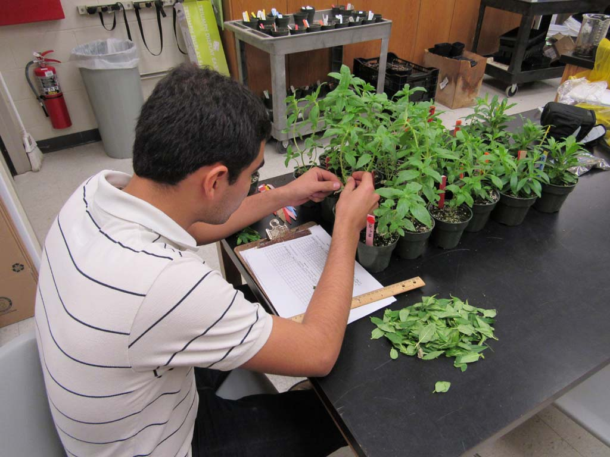
K-State Horticulture Program
Undergraduate Research Opportunities
Notes:
Undergraduate students are highly encouraged to participate in undergraduate research experiences. There are many opportunities for students to engage and be a part of research programs in the department and on campus. These experiences range from simple to complex research projects and are great learning experiences for students. And they are not limited to students participating in the horticulture science specialization part of the program. The benefits from students doing undergraduate research are wide reaching from receiving credit for engagement, to published work, to valuable, career applicable experiences, along with awards and recognition. Students will work alongside research faculty and graduate students, who will be mentors through the experience.

Slide 24
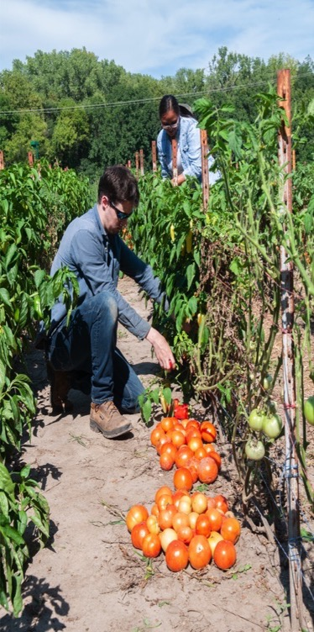
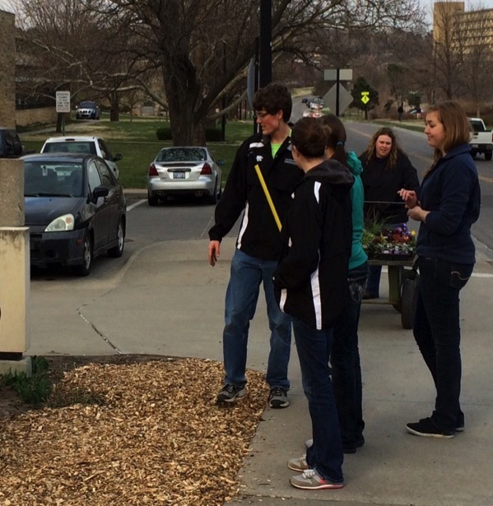
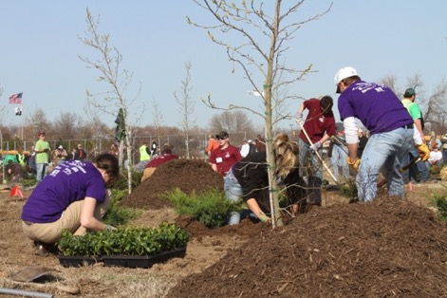
K-State Horticulture Program
Student Clubs
Horticulture Club
Willow Lake Student Farm Club
National Collegiate Landscape Competition
Golf Course Superintendents Association of America
Notes:
Each area of the program has excellent opportunities for students to become more engaged in their discipline. There is the Horticulture Club, the Willow Lake Student Farm Club, the National Collegiate Landscape Competition Team, and the Golf Course Superintendents Association of America club. Students are highly encouraged to participate.
The clubs provide opportunities for students to gain experiences related to:
hands-on learning
leadership
outreach
community engagement
interact with industry people, through guest speaker experiences and field trips

Slide 25
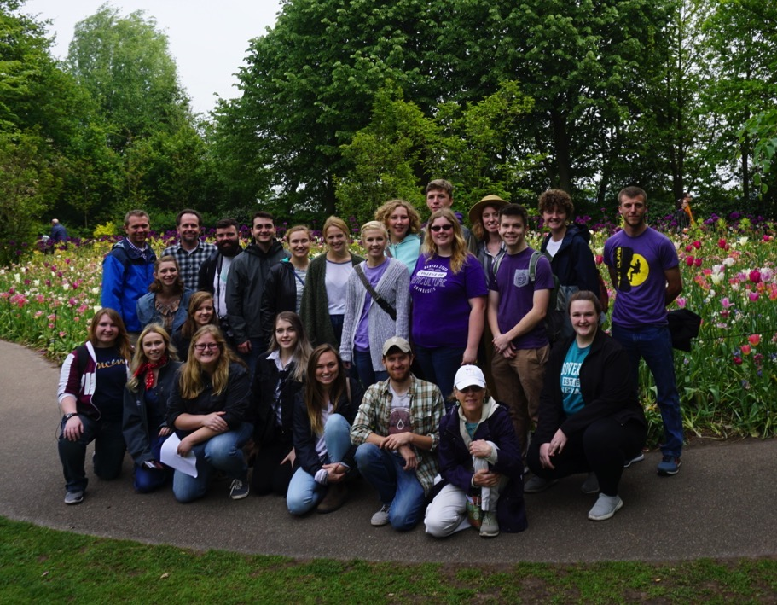
K-State Horticulture Program
Study Abroad Opportunities
Netherlands, Belgium, Luxembourg, and France 2019
Notes:
Study Abroad Opportunities are offered on a semi-regular basis, about every other year or every third year. These study abroad trips are typically faculty-led, by faculty in the department. Students take a course with the travel experience and the course is used towards their program of study. The study trips are cost-effective and are great experiences for students who may not have done extensive travels.
Overall: Study Abroad trips:
are faculty-led.
are short-term; 10 to 15 days.
go to locations all over the world.
can count towards a student’s degree program.
There are funding and scholarship opportunities to assist students.

Slide 26
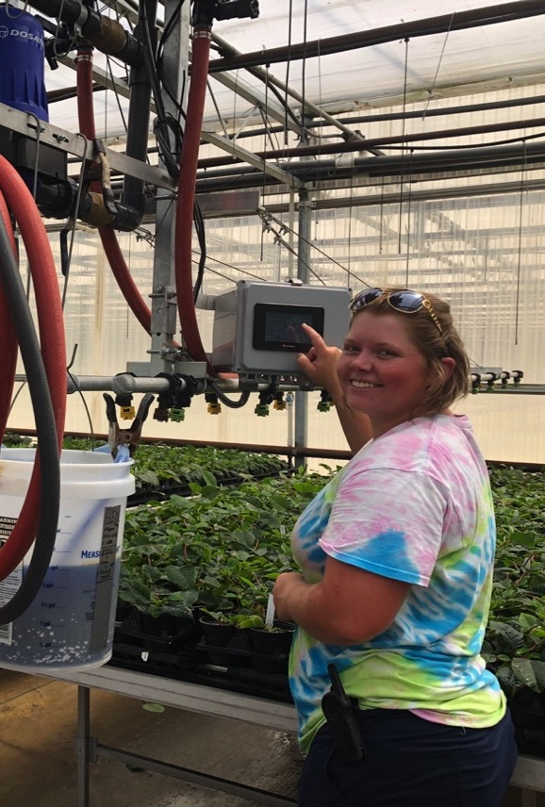
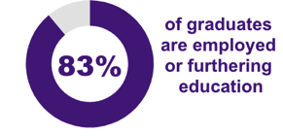
K-State Horticulture Program
Department Highlights
High Job Placement
Many students have more than one offer upon graduation
Notes:
Most of the students who graduate from the program have a job upon graduation. Students often secure the employment opportunities through their required internship experiences, through participation in campus career fairs, interacting with industry professionals through club activities, or through part-time work during their degree program. The faculty have strong connections with the industry and the industry regularly seeks out K-State Students.
Many graduates employed in the following states:
Kansas, Colorado, Missouri, Nebraska, and Oklahoma

Slide 27
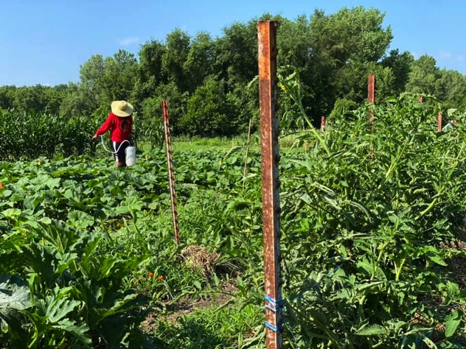
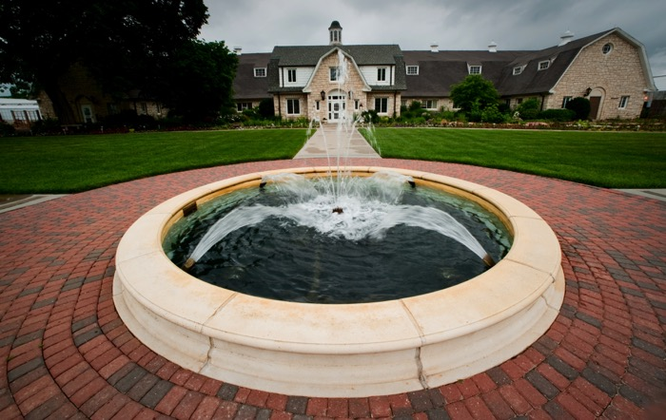
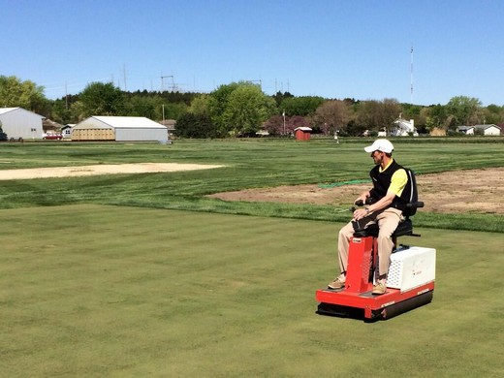
K-State Horticulture Program
Great hands-on Learning Facilities
Willow Lake Student Farm
KSU Gardens
Rocky Ford Turfgrass Plots
Notes:
There are great facility resources on or near the K-State Campus that provide excellent hands-on learning opportunities for students. These include the KSU Gardens, the Willow Lake Student Farm, and the Rocky Ford Turfgrass Plots. All of these locations are regularly used by multiple courses in the department as locations to conduct laboratories and other experiential learning activities.

Slide 28
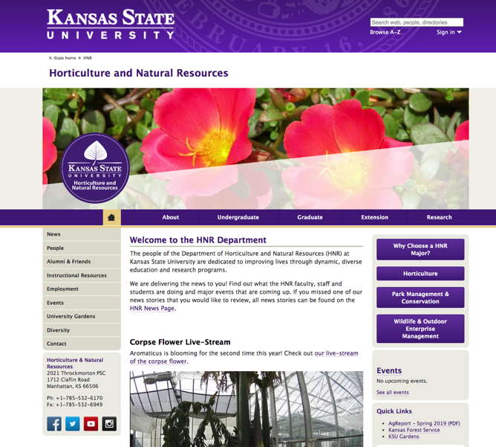
For additional information:
Talk to your teacher!
Talk to your guidance counselor!
Visit campus!
Visit the Horticulture and Natural Resources Homepage
www.hnr.k-state.edu
@KStateHNR
K-State Department of
Horticulture and Natural Resources
kstatehnr
Notes:
If you are interested in horticulture or plant sciences, connect with us! Or a nearby horticulture institution—if it’s not K-State!

Slide 29
Other Degree Programs
Bachelor’s degree may not be of interest! That is fine!
Many benefits associated with 4-year degree, but it doesn’t mean we don’t have great horticulturists and agriculturists in the field
Community Colleges or Associates Degree Programs!
Looking for practical and hands-on training
Johnson County Community College
Coffeyville Community College
Notes:
A 4-year degree program may not be of interest—and we recognize that! It may not be for some. BUT…AND…there are still many opportunities for great career options in the horticulture and plant science industry. We would encourage you to explore a nearby community college, that would provide some general plant science and horticulture courses. There are a couple programs that do offer 2-year associate degrees in horticulture. Explore! And if through those opportunities it becomes clear that maybe a 4-year bachelor’s degree might be good for you, check out the K-State program! Many courses will count towards your degree at K-State.

Slide 30
Project funded by:
USDA Secondary Education, Two-Year Postsecondary Education, and Agriculture in the K-12 Classroom Challenge Grant (SPECA) Award No. 2017-38414-26963

