Slide 1
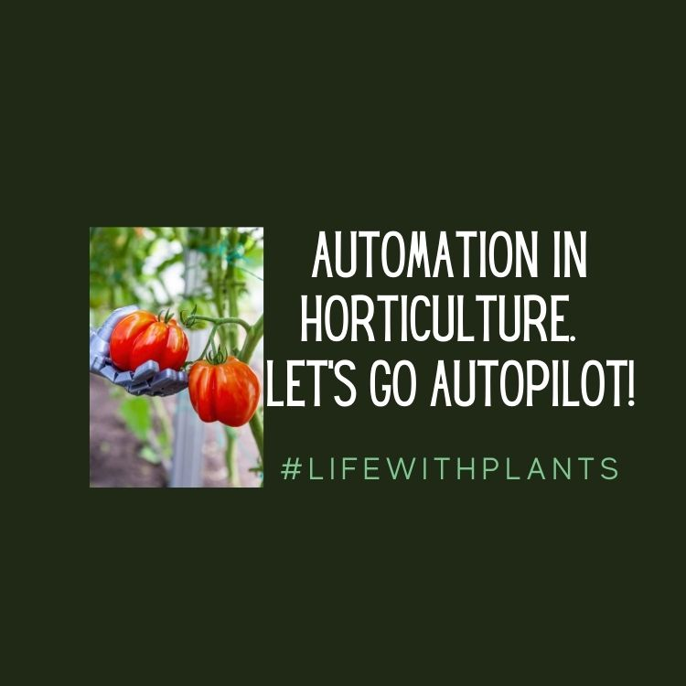

Slide 2
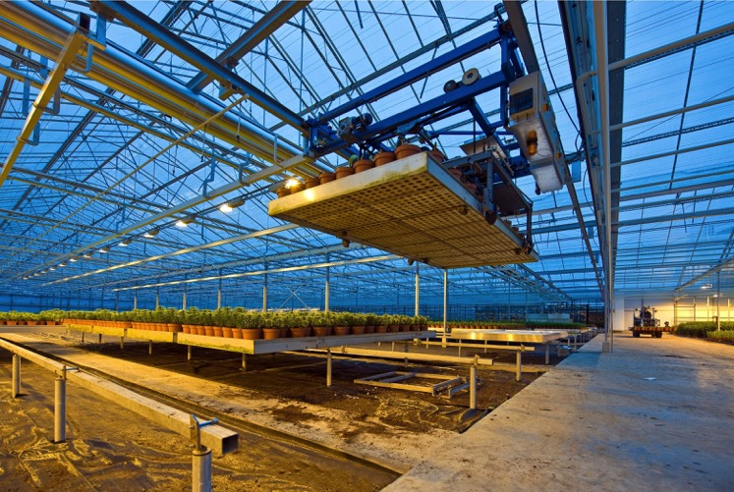
Introduction
What is mechanization?
What is automation?
Examples of automation in horticulture and plant science related fields
Career opportunities
Notes:
This is the class overview for automation. We will define automation and better understand it’s use and significance in the horticulture industry. Several examples will be shared and shown. Students will also learn about different horticulture and plant science career opportunities that would include facets of automation.

Slide 3
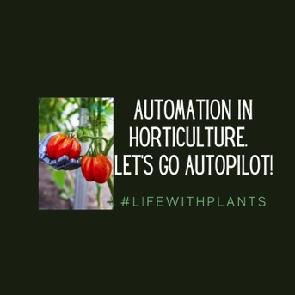
Learning Objectives
Students will:
be able to describe different ways the horticulture and plant science related fields industry are automated
be able to identify automation practices in horticulture and plant science related fields
be able to describe advantages and disadvantages of automation in horticulture and plant science related fields
Notes:
These are the class objectives associated with the Automation in the horticulture industry.

Slide 4
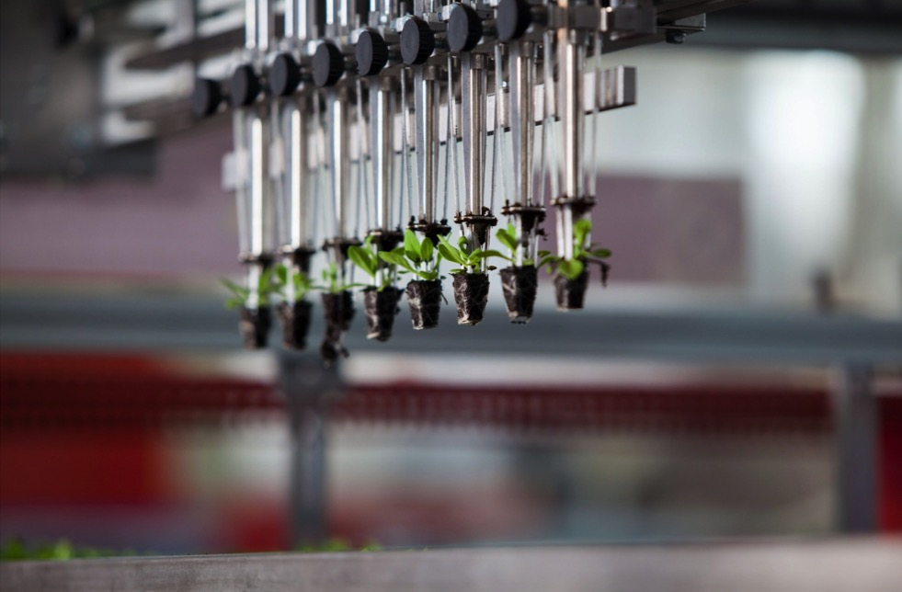
Automation
What is Mechanization?
“The process of putting an apparatus, operation, or system under the control or regulation of mechanical or electronic devices.”—Merriam Webster
Notes:
The dictionary definition of mechanization is: the process of putting an apparatus, operation, or system under the control of regulation of mechanical or electronic devices. (Merriam Webster).
When we think of or describe facets of the horticulture industry and plant science related professions, particular areas of the industry can include many different (highly) mechanized . This is often the case in large production facilities and certainly many facilities in Europe. More and more facilities in the United States are increasingly automated through mechanization and robotic aspects.
Examples of this mechanization that are involved in automation will be presented in this presentation.

Slide 5
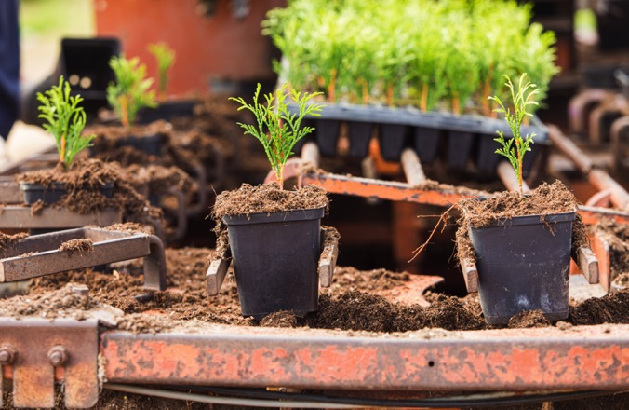
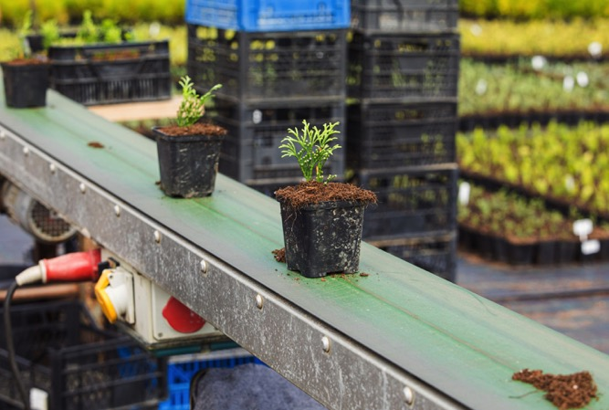
Automation
What is automation?
Dictionary: “The technique of making an apparatus, a process, or a system operate automatically.”
International Society of Automation: “the creation and application of technology to monitor and control the production and delivery of products and services.”
Notes:
The dictionary definition is: The technique of making an apparatus, a process, or a system operate automatically.
The International Society of Automation has a similar, comprehensive definition of: “the creation and application of technology to monitor and control the production and delivery of products and services.”
In the pictures shown, are a couple of nursery automated planting lines. They are planting evergreen shrubs into small pots.
Reference the GPN article: Automation vs. Mechanization.

Slide 6
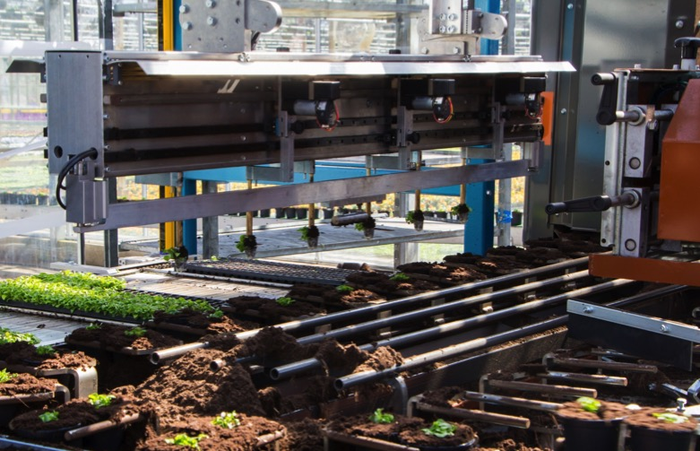
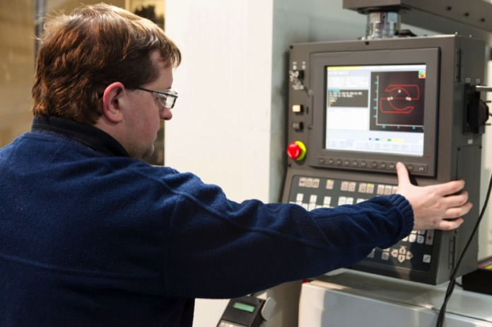
Automation
Operations with enhanced technologies in horticulture, including nurseries and greenhouses, can be classified into two groups:
Mechanized and Automated
What’s the difference?
Notes:
So then, what exactly is the difference between ‘Mechanization’ and ‘Automation’?
Mechanization: Replacement of a single human task with a machine and often humans involved in another part of the process. One part or two parts of the assembly line are robots/machines.
Automation: Generally the ENTIRE process is integrated and likely very little to no human involvement at a major step in the process. Whole assembly line is robots/machines.
Example: The pots are filled by a machine, rolls down the assembly line and then a machine plants a seed and then moves down the line and watered by a machine. Then the pot is automatically rolled onto a large bench and the bench is then moved out to the greenhouse when it is full. The plants grow out in the greenhouse, watered from underneath and then after the plant has grown, the benches automatically move back to the head house. They are then put on a cart to resell.
Most of what the industry has implemented has been mechanization. And more recently, systems and processes have been more automated. It could be argued that with plants, fully automating a whole production system is challenging, as human intervention is often needed, especially if one particular part of the process hasn’t been automated. However, with increased mechanization and innovation, combining many parts of production processes in horticulture can or are nearly fully automated. For example: We observe mechanized planting lines Or, we observe mechanized watering practices. But with new systems, we can see all of those combined.
(Information based on study Posadas et al., 2008; Automation vs. Mechanization, Porter, 2002) Suggested Video to Watch: Behind the Scenes at Ter Laak Orchids (6:49)
Shows several examples of automation.

Slide 7
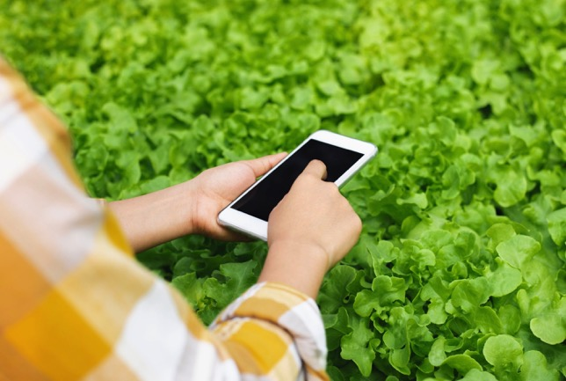
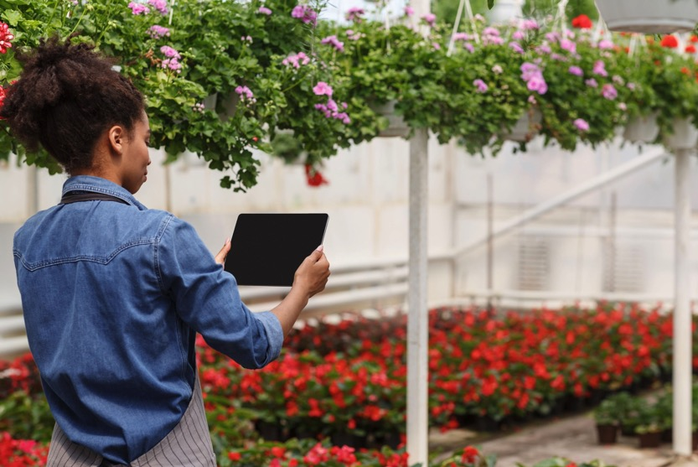
Automation
Horticulture Applications
“Smart Agriculture”
Notes:
Both mechanization and automation can lend themselves well to the concept of “Smart Agriculture.” Smart agriculture is the emerging concept centered around conducting and implementing agriculture practices (including horticulture) using technologies, such as automation, robotics, and artificial intelligence applications. In smart agriculture, a major goal is to increase the quantity and quality of products and optimizing the amount of required human labor required during production.
Many of the smart agriculture approaches can be mobile and portable, providing real-time feedback and opportunities to refine and optimize in a split second.

Slide 8
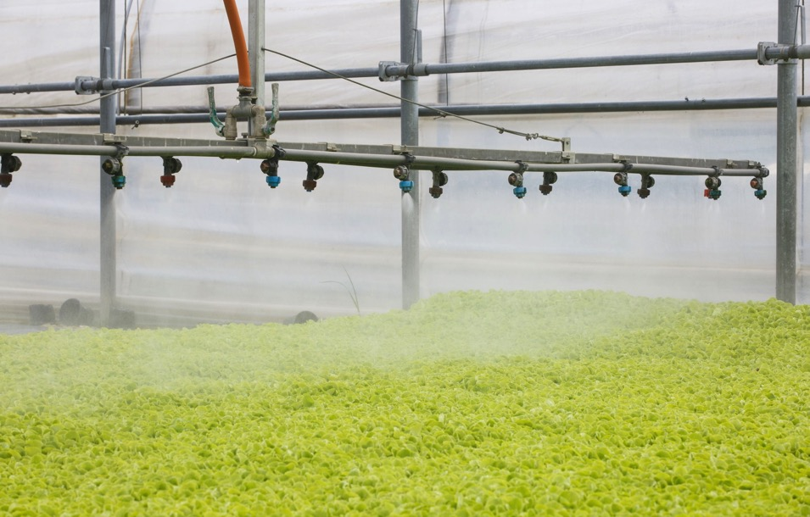
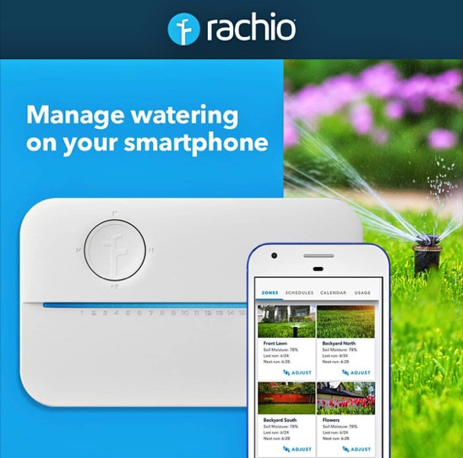
Automation
Horticulture Applications
Irrigation
Greenhouses
Landscapes
Notes:
Irrigation systems in greenhouses, for example, have for many years been mechanized. Although for many facilities, hand watering is still a very viable method, many larger facilities have invested in irrigation systems that are highly automated. These include boom systems (as shown in the picture in the right), in which a boom of emitters moves at a given speed over a large area of a production facility. Or the boom can deliver water through emitters to provide bench watering (in the video). The irrigation can be controlled for frequency and intensity, along with applying fertilization. Additionally, pesticides and plant growth regulators can be applied using these systems.
One person can water many, many more plants at one time than if hand labor and watering were to be employed.
The lower left photo is an example of the increasing number of options for ‘Smart Agriculture.” Not only are there apps and programs available for greenhouse and horticulture production facilities, but there are also apps and technologies available for homeowners and general public, to automate. Apps like Rachio provide automation options via a mobile phone for irrigating in the landscape.
Suggested Video to Watch: Logiqs Automatic Irrigation Booms (2:22)

Slide 9
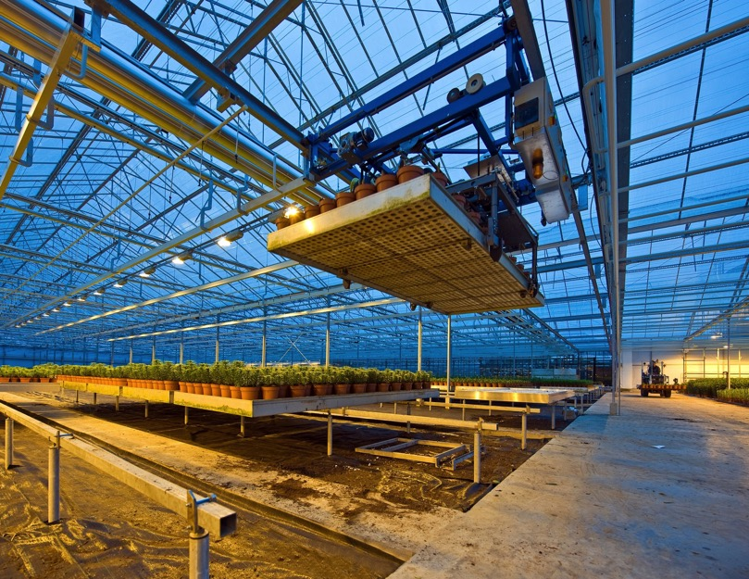
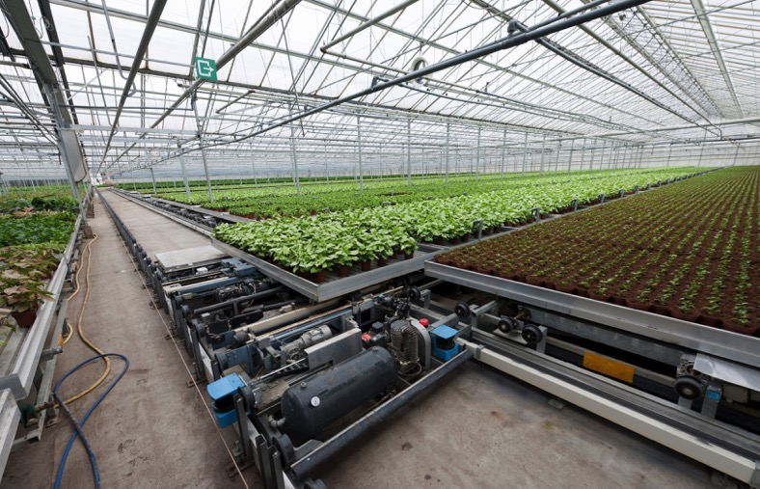
Automation
Horticulture Applications
Benching Systems
Greenhouse Production
Notes:
One relatively common method of automation observed in horticulture production, especially in greenhouse and protected environment situations, is mechanized and automated benching systems. In these systems, large production benches can be moved and organized for space optimization, in that, there is little room required for human access. Often if human activity is needed for a particular bench, the benches can be programmed to ‘arrive’ or move to an area where humans can interact, often in a head house or the front of the greenhouse. These systems can be quite elaborate, lifting benches up and over, perhaps to/from a different level in the facility (upper right image), along with general moving them from the front to the back, or to a different growing area or range (lower left image).
Suggested Video: Automated Benching Systems (12:22)

Slide 10
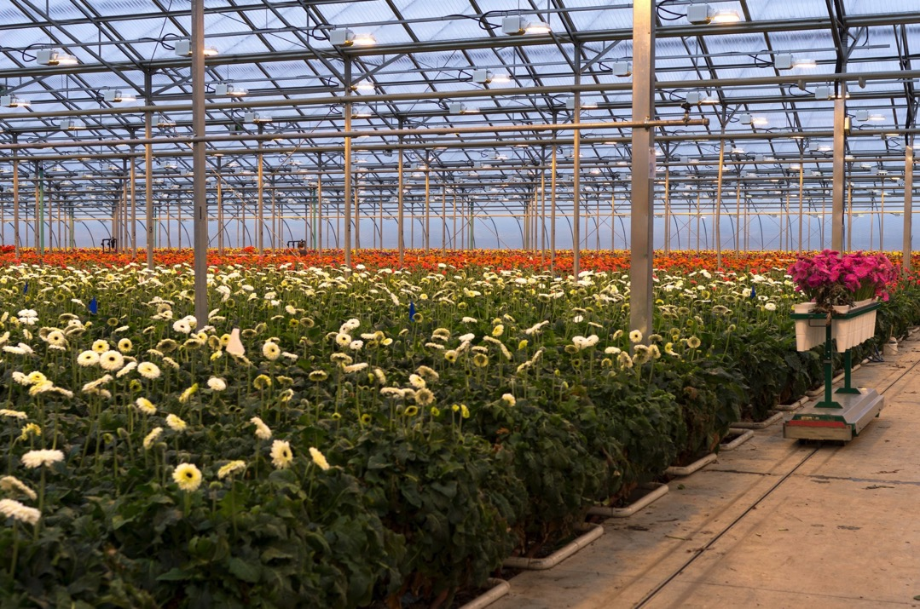
Automation
Horticulture Applications
Greenhouse Production
Product Transport
Notes:
Another example of automation in greenhouse production, can be observed in modern cut flower facilities. Flowers may or may not be cut by a machine, or if not by machine, by humans. Then the cut flower products are placed in trolleys that then automatically move the product to the flower processing area, often in the head house or a large area near coolers. These trolleys, like the one shown in this picture, follow guides, and move the products without need for human interaction.

Slide 11
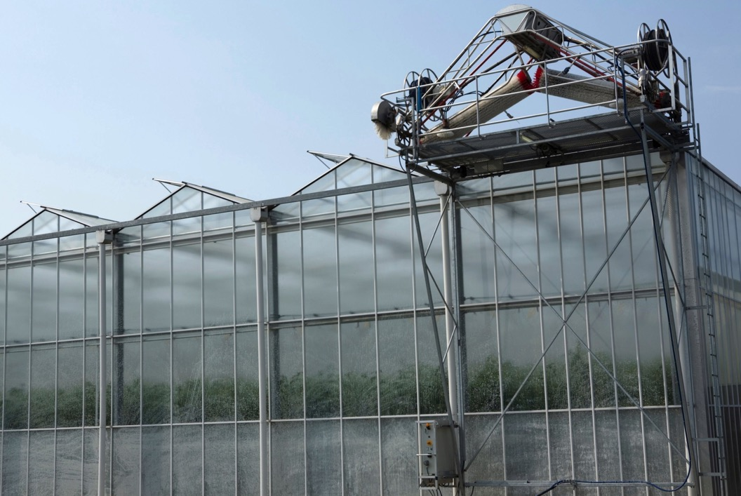
Automation
Horticulture Applications
Greenhouse Cleaning
Notes:
In addition to automation directly related to production of plant materials and products, there are automated processes that assist in maintaining production facilities. For example, in this slide you see greenhouse cleaning automation. This application washes and cleans the greenhouse glass panels, as to maximize light transmission into the greenhouse.

Slide 12
Automation
What do you think are advantages to automation? Disadvantages?
Advantages
Saves labor!
Plant hundreds more per hour compared to hand labor
Can be operated by one (or few people)
Accuracy resulting from data driven decisions based on facts.
Increase quality and yield
Example: laser ‘eyes’ built in
Select for disease
Uniformity
Disadvantages
COST (initial investment)
Challenges if breaks down
Fixing timeline
Costs
Could be hard to get manual labor to fill in
Notes:
This is an activity slide.
Students could get together in pairs, or small groups, and brainstorm the different advantages and disadvantages of having automation and mechanization in a horticulture enterprise.

Slide 13
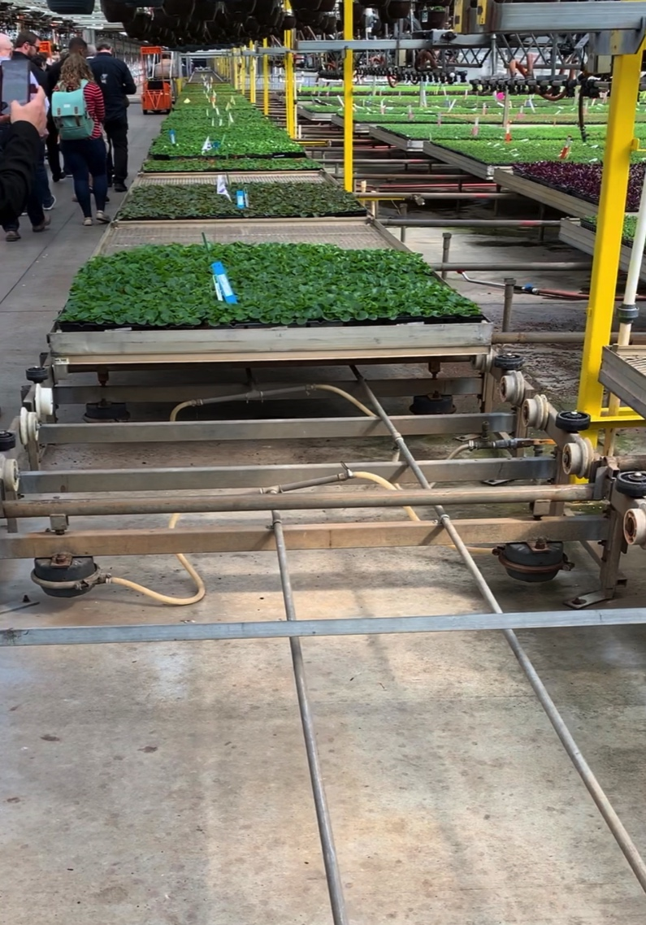
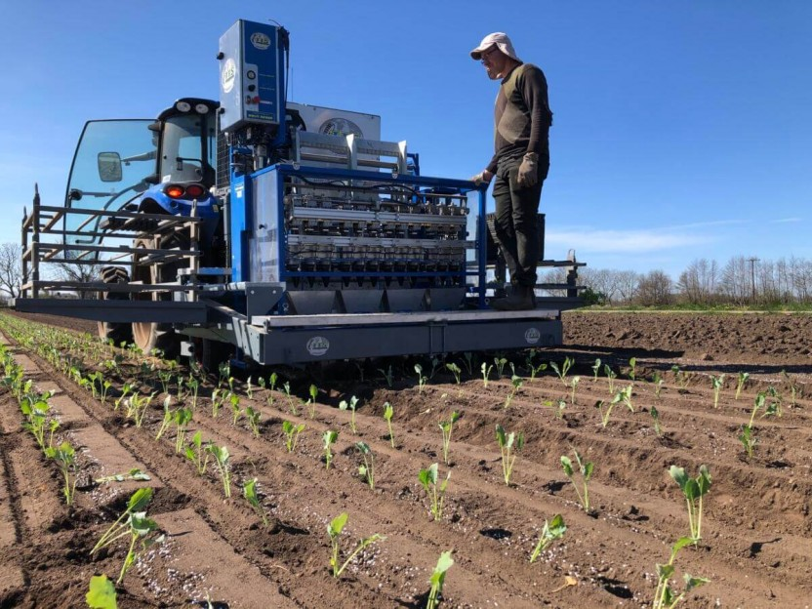
Automation
Career Examples
Greenhouse Grower
Olericulturist
Image Credit: Transplant Systems
Notes:
There are several careers within horticulture and the plant science fields that will allow someone to experience and interact with automated systems. That could range from someone troubleshooting a system or programming, to someone overseeing the automated feature, making sure there are no issues during the specific tasks being performed.
For example: A greenhouse grower, could easily use and implement on a daily basis, use of automated benches (as was highlighted in a previous slide; see video: Automated Benching Systems).
An olericulturist (vegetable producer) might use an automated planter for field planting lettuce transplants (see video: Automated Lettuce Transplanting).
( Image Credit: https://www.transplantsystems.co.nz/products/sfoggia-florida-transplanter-241-242-243/ )
A student activity could be for the class to consult with the list of careers (Horticulture Careers and Salary file) under the “Careers in Horticulture” module. In that activity, they could identify the different careers in which automation and mechanization could be involved, at some level. They could identify the different types of automation and mechanization and to what extent they are used in a given profession.

Slide 14
Project funded by:
USDA Secondary Education, Two-Year Postsecondary Education, and Agriculture in the K-12 Classroom Challenge Grant (SPECA) Award No. 2017-38414-26963

